Slide 1
Commonsense Reasoning
These slides are from the ACL 2020 Commonsense Tutorial by Yejin Choi, Vered Shwartz, Maarten Sap, Antoine Bosselut, and Dan Roth

Slide 2

Monsters in a Tunnel
Two monsters are running (rather than standing still on one foot)
One is chasing another (rather than trying to copy his movements)
The chaser has hostile intentions and the chased is afraid (even though two faces are identical)
Important Observations:
A great deal of intuitive inferences are commonsense inferences, which can be described in natural language.
None of these inferences is absolutely true. The inferences are stochastic in nature. Everything is defeasible with additional context.
Commonsense inferences are about predicting new information that is likely to be true based on partially available information.
Important Observations:
A great deal of intuitive inferences are commonsense inferences, which can be described in natural language.
None of these inferences is absolutely true. The inferences are stochastic in nature. Everything is defeasible with additional context.
Commonsense inferences are about predicting new information that is likely to be true based on partially available information.
Notes:
Roger Shepard’s “m

Slide 3
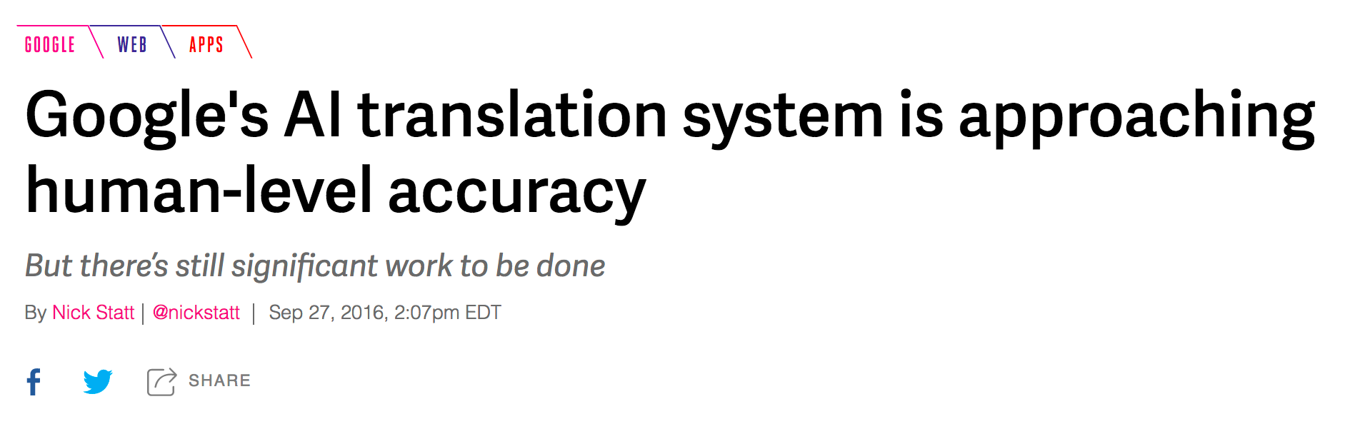
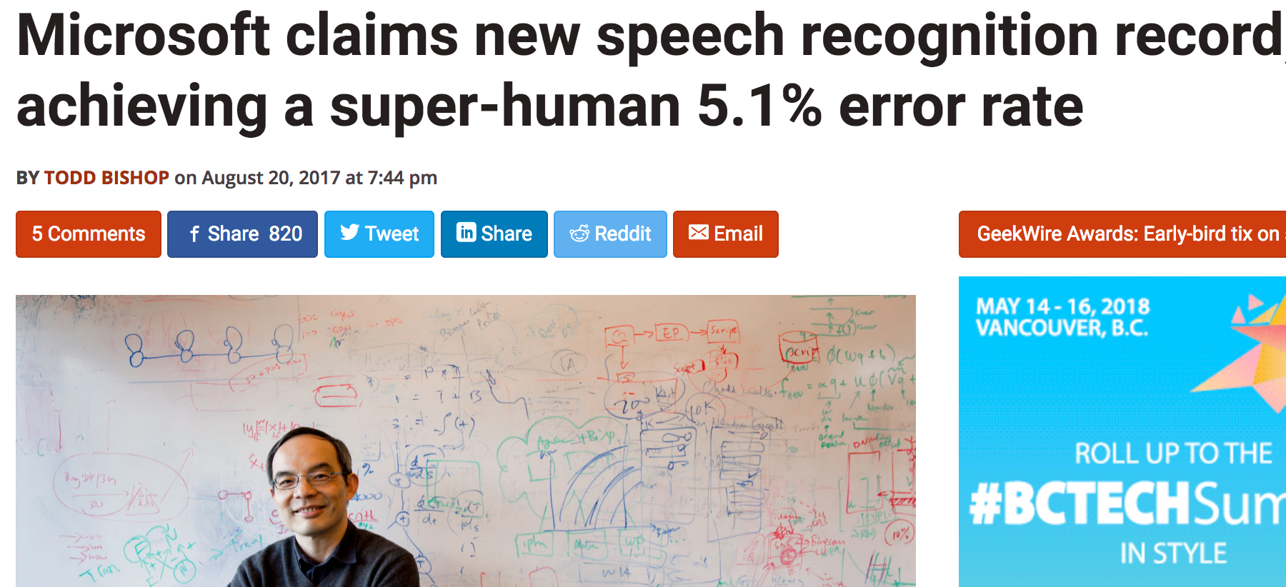
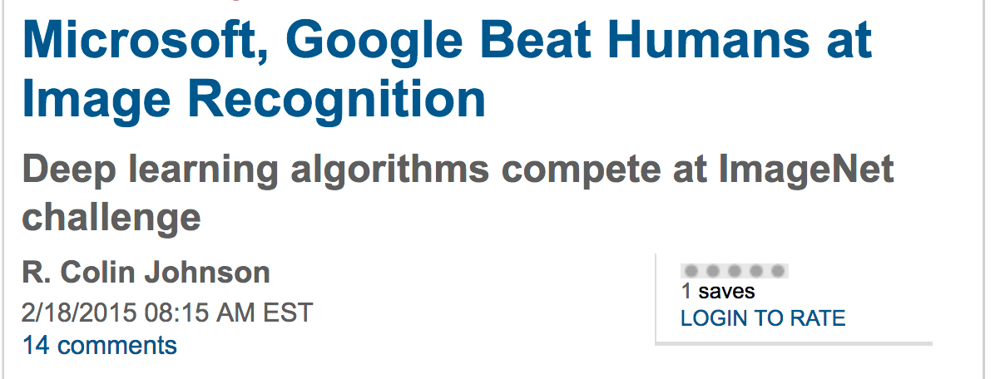
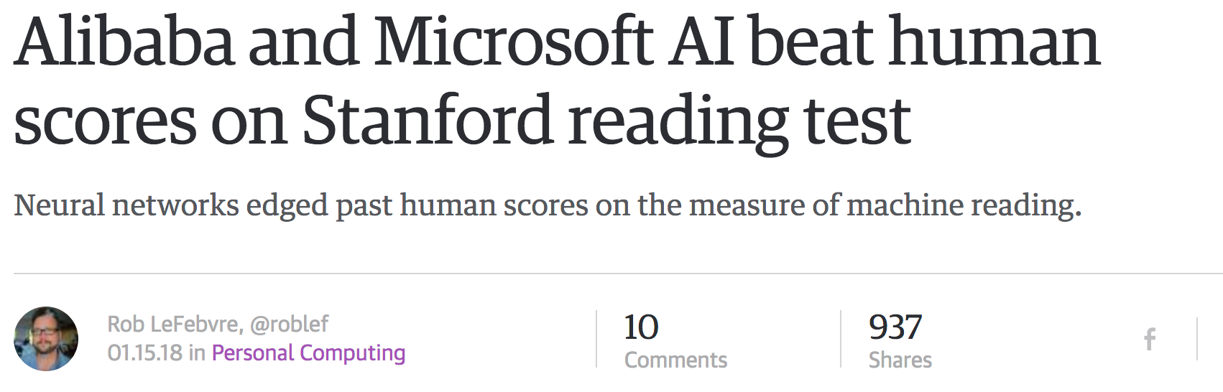
Claims of AI systems reaching a “human level”

Slide 4
We may be ”solving” datasets rather than the underlying “task”
Notes:
It’s not just this problem though. The existing deep learning paradigm has been hugely successful, but there are notable shortcomings that go beyond examples that specifically require commonsense knowledge. CLICK
Strong deep learning models for object recognition misclassify objects when random noise is applied CLICK
In the task of visual question answering, often times the models just revert to priors that are in the dataset without doing reasoning. CLICK
Captioning models are often generic and very similar to the dataset that they were trained on. CLICK
Dialogue models are often bland CLICK
and this issue gets worse if we want to generate a longer document. Even though recent work has improved this, there are still major shortcomings. CLICK
Last, question answering models are easily fooled with distractor sentences. Interestingly enough, all of these failure modes are seen with state of the art systems that do seemingly well on existing metrics and datasets. CLICK
And the impact of these failure modes isn’t just on accuracy, it’s been shown that when models make mistakes they tend to repeat unwanted social biases.

Slide 5
Theory of Core Knowledge
Domain | Description
Objects | supports reasoning about objects and the laws of physics that govern them
Agents | supports reasoning about agents that act autonomously to pursue goals
Places | supports navigation and spatial reasoning around an environment
Number | supports reasoning about quality and how many things are present
Forms | supports representation of shapes and their affordances
Social Beings | supports reasoning about Theory of Mind and social interaction
Developmental psychologists have shown that children develop the ability to reason about these domains early in life. Such reasoning is important for later learning.
Notes:
Researchers who study childhood cognition now have years of experimental results that allow them to map out the cognitive capacities of children. The field of cognitive development is at a point where it can provide empirical and theoretical guidance for building intelligent machines that think and learn like children. In particular, developmental psychologists have intensively studied children's knowledge in six domains (Table 1). Some believe that each of these domains constitutes a distinct and relatively autonomous system of knowledge, an idea that has been codified in the Theory of Core Knowledge. Others believe that these domains interact from the beginning of life. Developmental psychologists agree, however, that abilities to reason about objects, agents, places, number, geometry, and the social world, as described in the Theory of Core Knowledge, emerge early and serve as crucial foundations for later learning [61][62][63]:

Slide 6
Definition of Common Sense
The basic level of practical knowledge and reasoning
concerning everyday situations and events
that are commonly shared among most people.
It’s OK to keep the closet door open
It’s not OK to keep the refrigerator door open because the food might go bad
Essential for humans to live and interact with each other in a reasonable and safe way
Essential for AI to understand human needs and actions better
Notes:
These are the set of rules that we rely on for rules of thumb

Slide 7

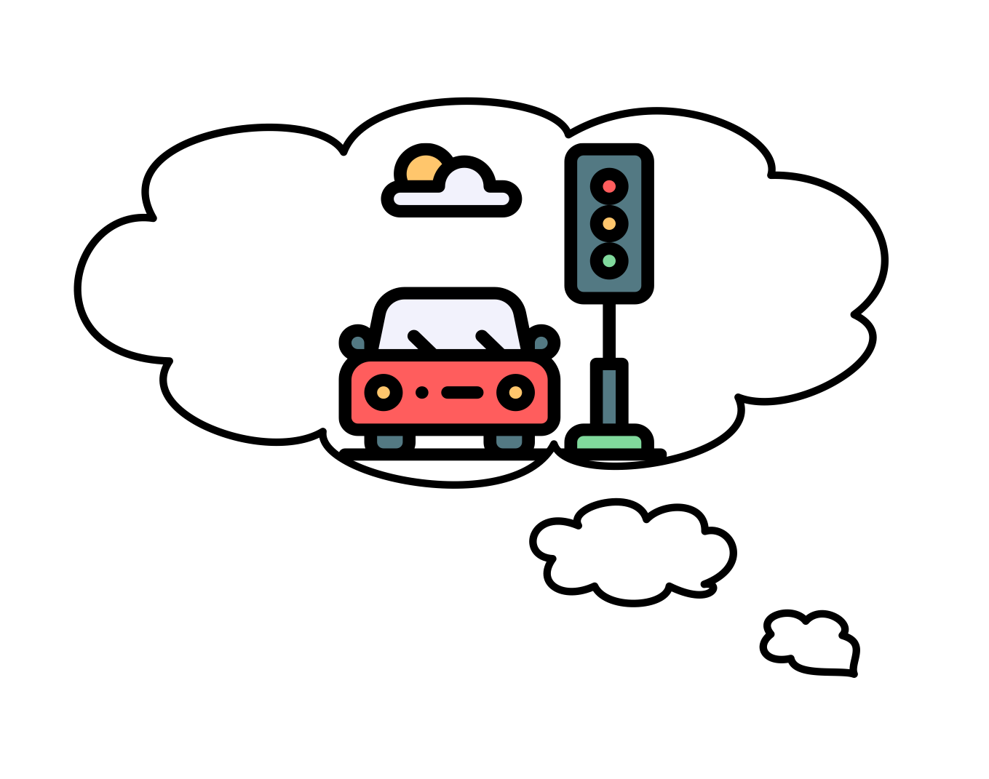



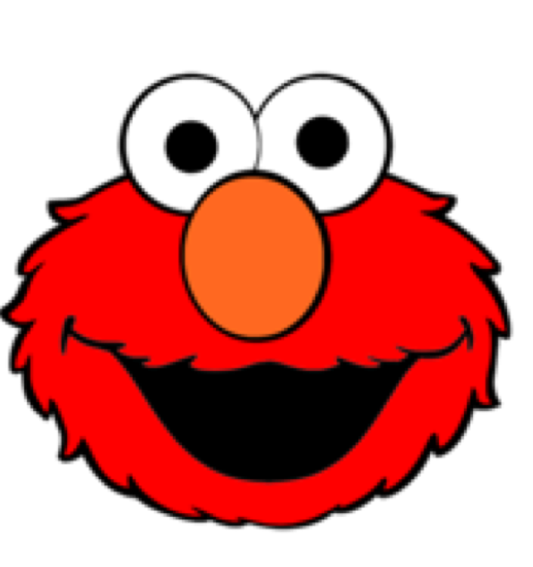
Let’s bridge this gap!
Notes:
What we’ve observed is that humans, and today’s state-of-the-art ML models, use very different reasoning strategies. humans are able to do so well at answering the earlier questions because we can imagine the situation in our heads. We know if you stop for at most two seconds at a red light, you’ll probably run into traffic. Today’s machines don’t do that: instead, they seem to rely on spurious patterns. This is something we see across vision and language problems. These spurious patterns are powerful, but they also leave much to be demanded.

Slide 8
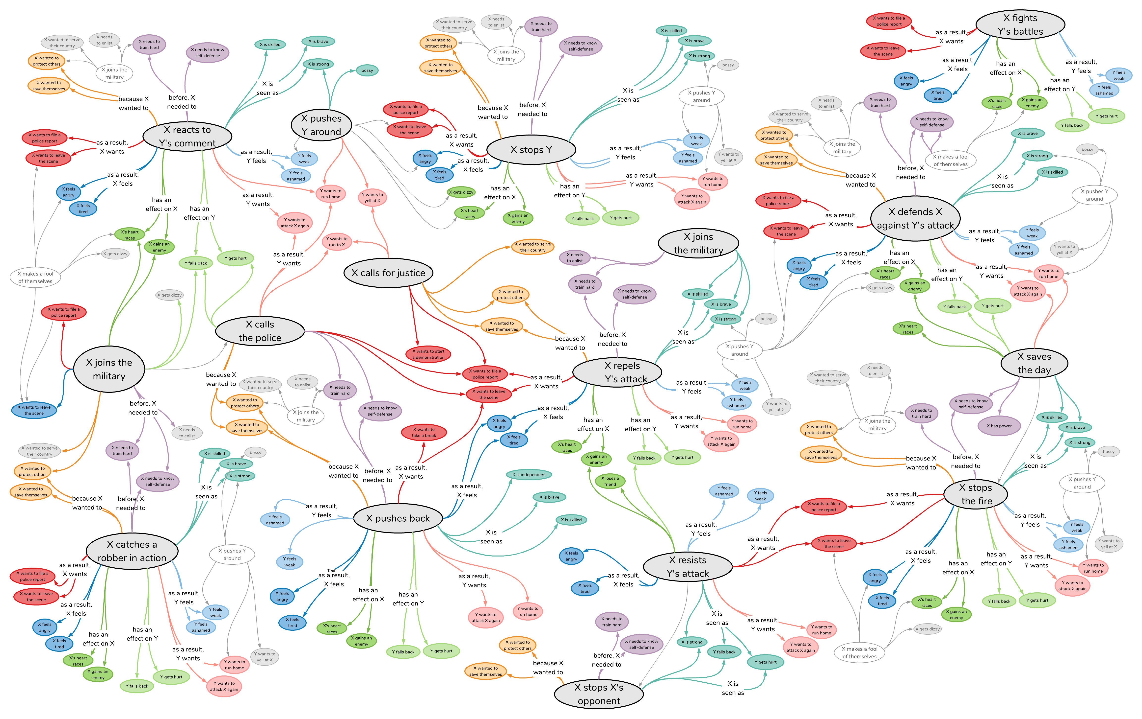
Commonsense resources

Slide 9
Outline
Goal: explain the existing resources of commonsense out there. Make sure to keep it entertaining (with a story)
Start with story.
We reason with mental models that draw from world knowledge -> that’s what commonsense resources aim to replicate
Overview of resources (timeline)
Overview of resources on a story
Cyc vs ConceptNet vs ATOMIC?
Challenges to gathering this knowledge (base this off ATOMIC slides)
Show the origin story of ATOMIC basically
Show why information extraction wouldn’t work (but work in the fact that these other ones are IE extracted which works cause it’s taxonomic)
Information extraction based techniques -> works for taxonomic knowledge
Reporting bias
Crowdsourcing works better
Summary?
Notes:
Goal: explain how to create a commonsense resource, and what the existing ones are out there!
Before this part: Vered explained what pretrained LMs already know.
Start: overall motivation of what commonsense resources aim to do (in spirit)
Show a story, explain that we fill in the gap with our own knowledge to understand the world, that’s what commonsense resources aim to do. Show the story again with some KB annotations.
Section: how do you create a commonsense resource?
First, you have to decide on representations, and on what type of knowledge you want to encode.
Example: ATOMIC: explain the type of social commonsense knowledge we wanted to use. And explain the motivation behind the type of knowledge.
High level timeline/overview of existing resources
Explain symbolic vs. natural language representations (related work of ATOMIC ++).
Section: How do you actually gather knowledge?
Pros of extracting from text: People start by trying to find them in text (cite). this can be very powerful, explain some IE type pipeline.
Con of extracting from text: Reporting bias!! Show example
Alternative: Experts create knowledge: Cyc, WordNet, etc. pros: it’s good quality, you can use specific representations (e.g., CycL, Gordon & Hobbs). cons:
Alternative: Non-expert humans in the loop / crowdsourcing! (that’s what ATOMIC & ConceptNet did)
That allows for seamless integration into natural language -> flash story again. How exactly we do that, Antoine is going to talk about later.

Slide 10

Grandma’s glasses
Tom’s grandma was reading a new book, when she dropped her glasses.
She couldn’t pick them up, so she called Tom for help.
Tom rushed to help her look for them, they heard a loud crack.
They realized that Tom broke her glasses by stepping on them.
Promptly, his grandma yelled at Tom to go get her a new pair.
Notes:
Add images

Slide 11
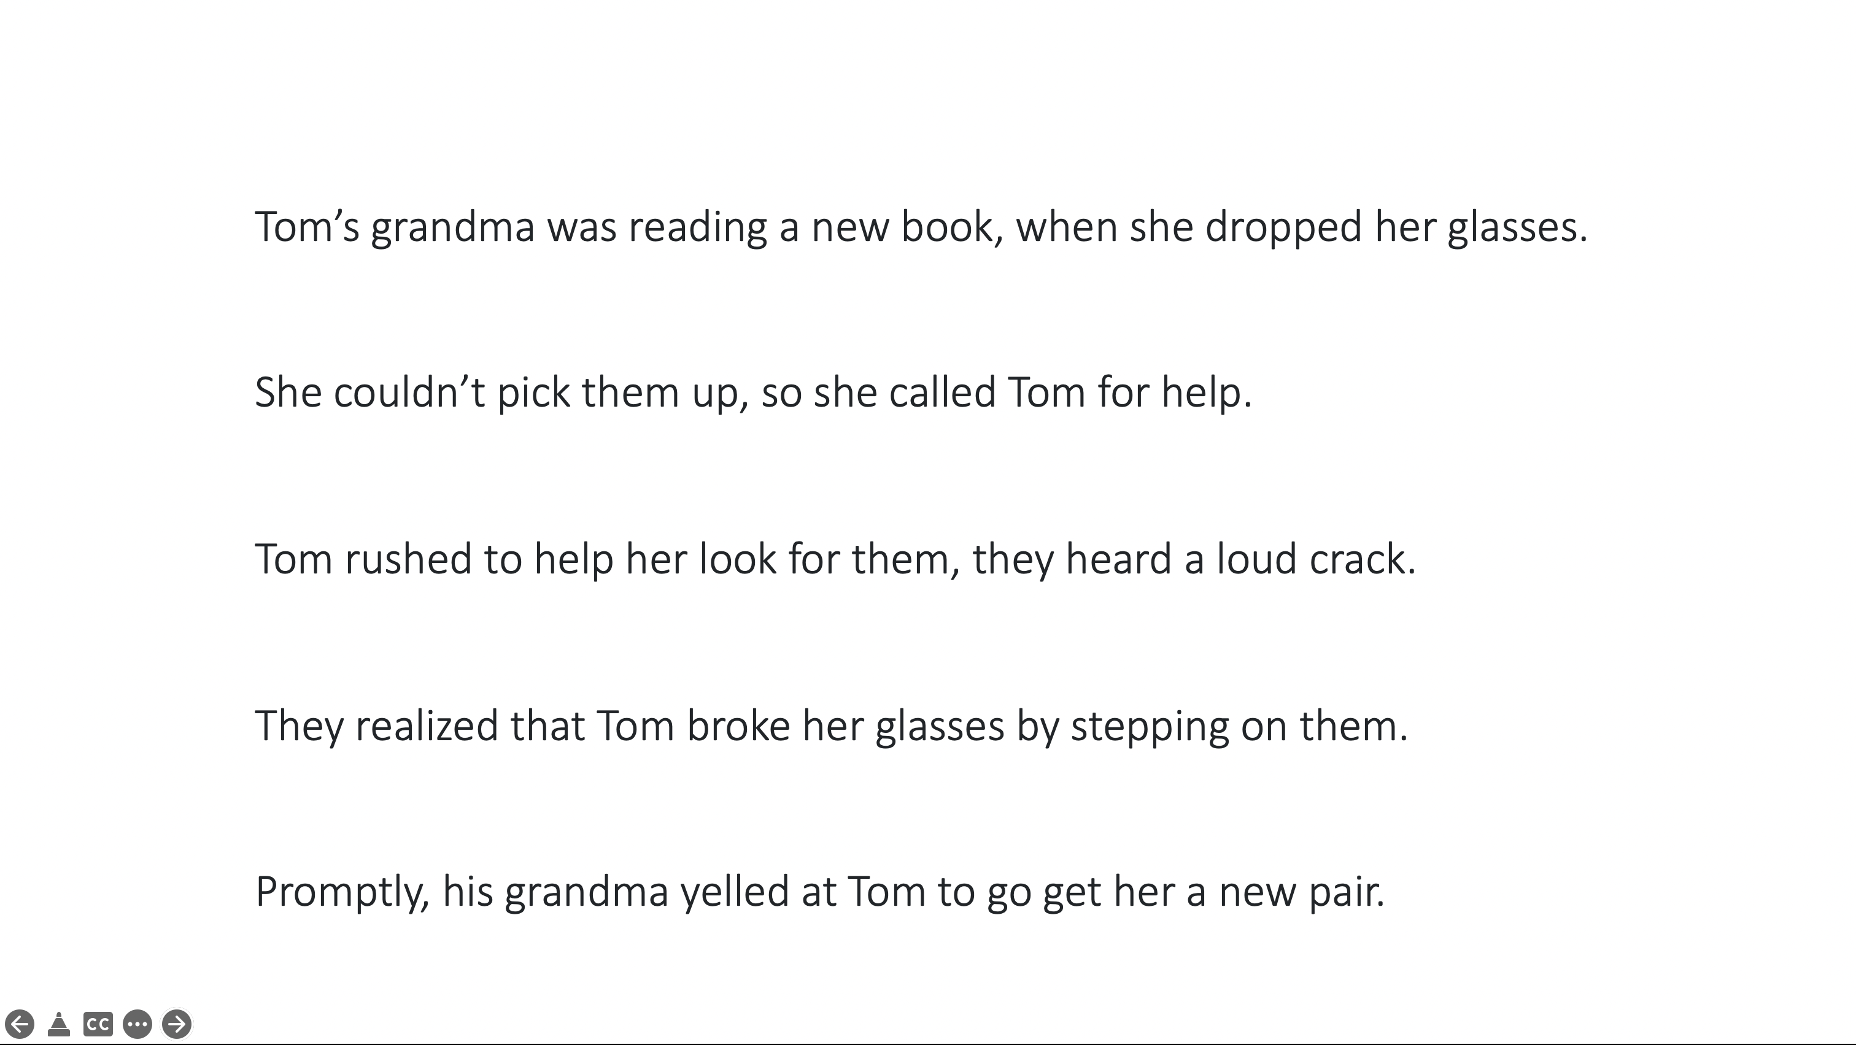
Grandma’s glasses
Notes:
Add images

Slide 12


Humans reason about the world with mental models [Graesser, 1994]
Commonsense resources aim to be a bank of knowledge for machines to be able to reason about the world in tasks
Personal experiences
[Conway et al., 2000]
World knowledge and commonsense
[Kintsch, 1988]

Slide 13
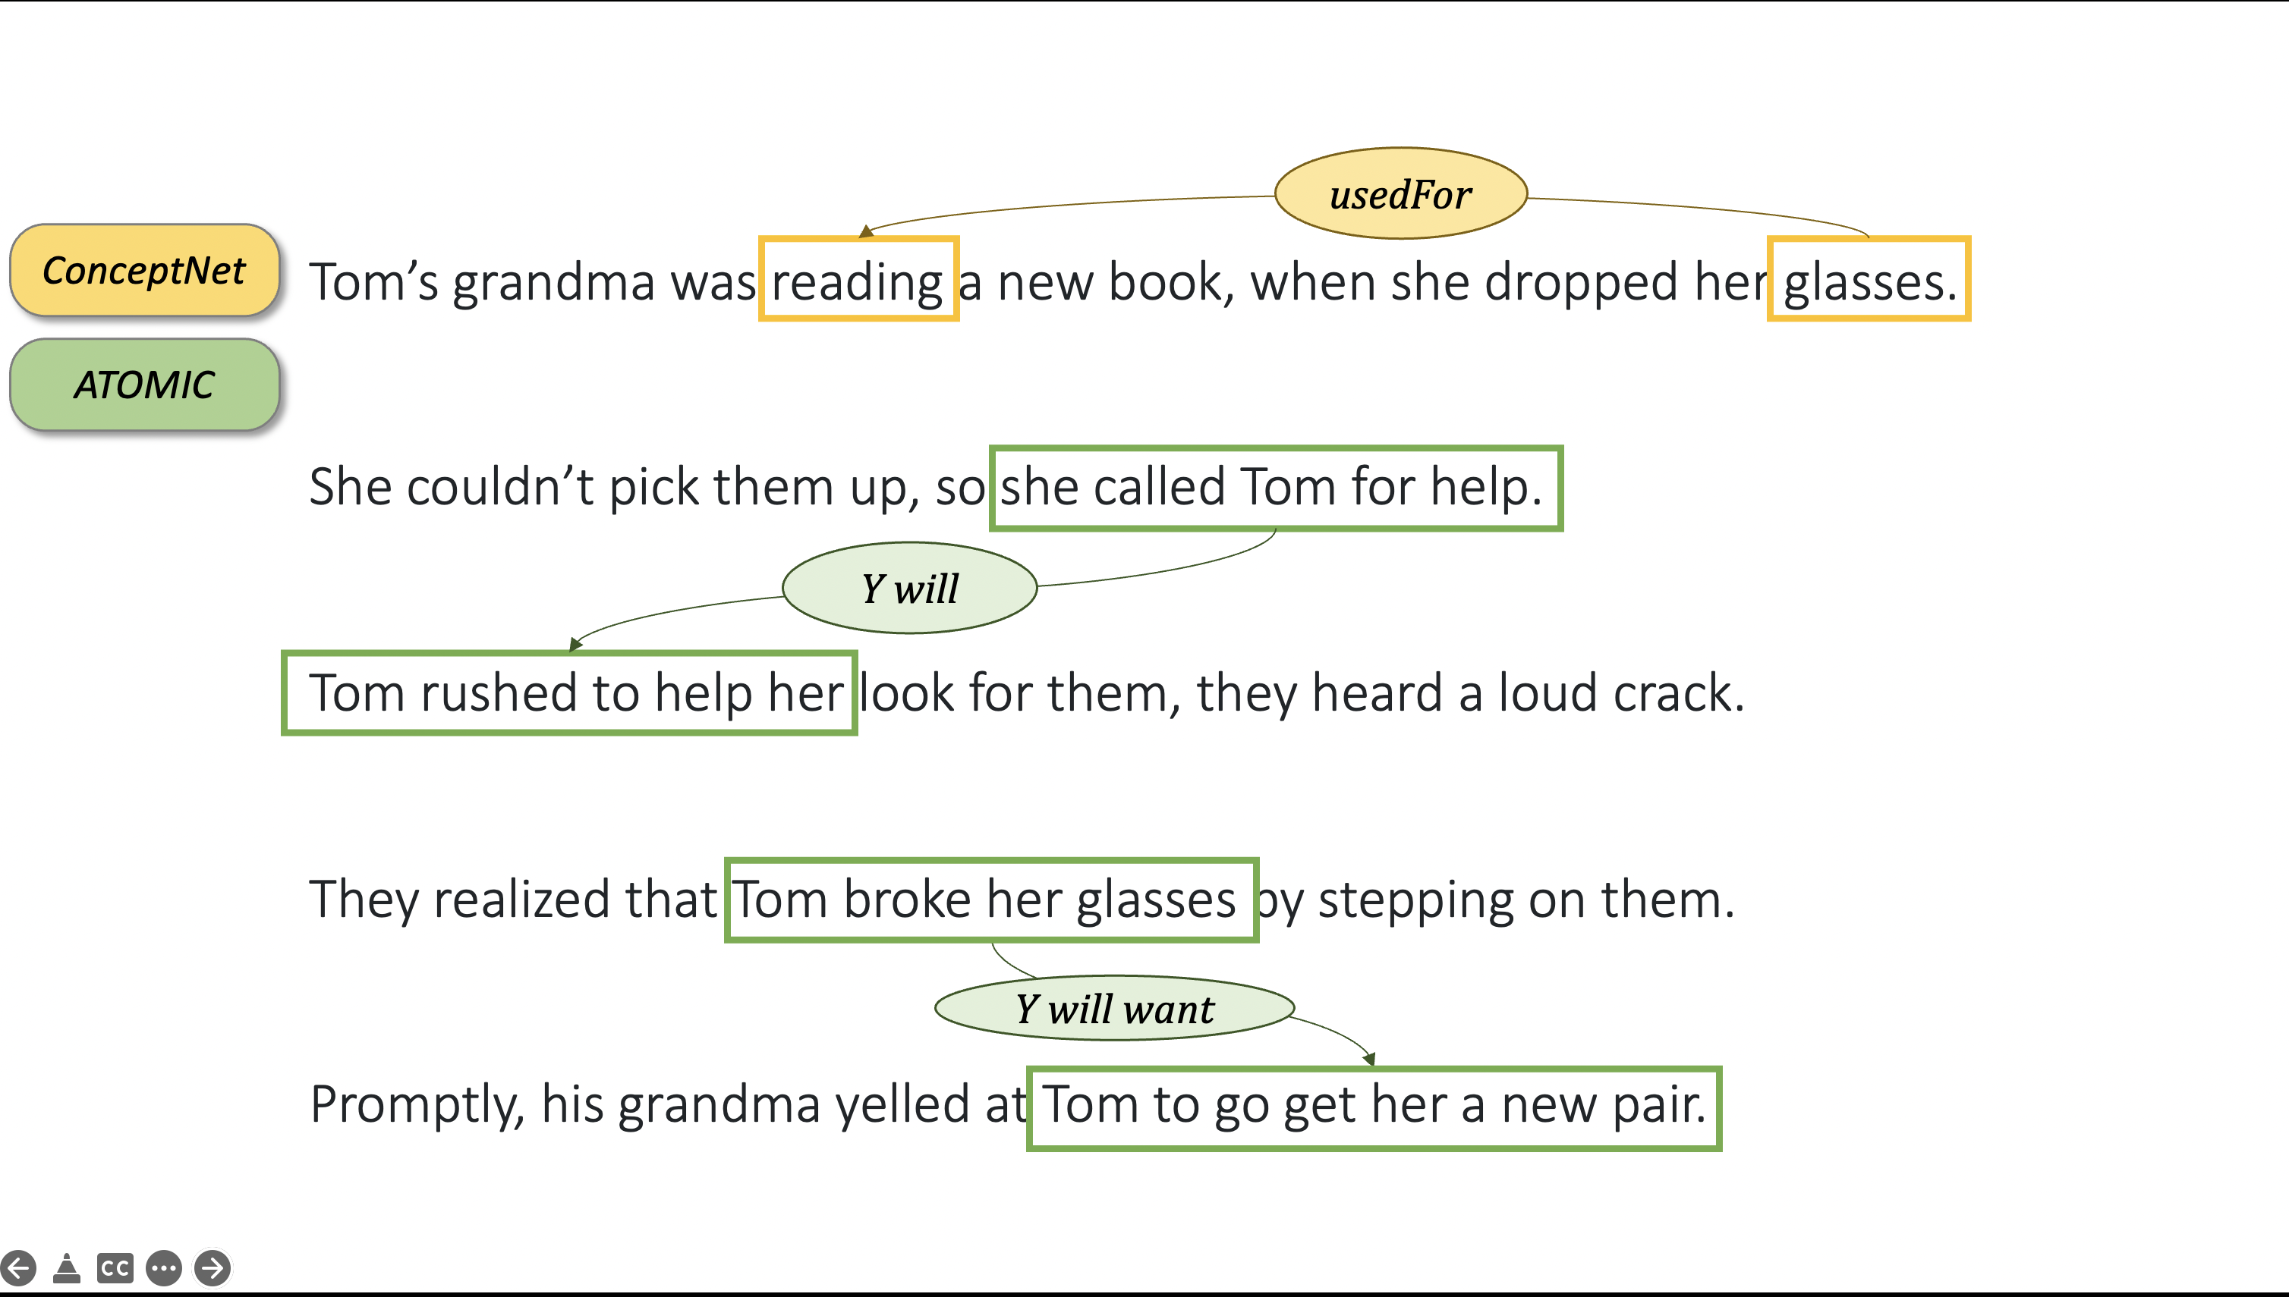

Slide 15
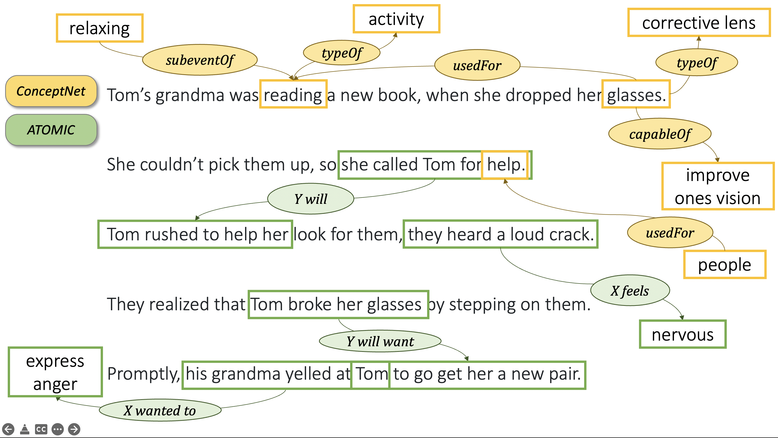

Slide 16
Overview of existing resources
ATOMIC (Sap et al., 2019)
Web Child (Tandon et al., 2014)
Web Child 2.0 (Tandon et al., 2017)
NELL (Carlson et al., 2010)
NELL (Mitchell et al., 2015)
Open Mind Common Sense (Minsky, Singh & Havasi, 1999)
ConceptNet (Liu & Singh, 2004)
ConceptNet 5.5 (Speer et al., 2017)
Cyc (Lenat et al., 1984)
OpenCyc (Lenat, 2004)
ResearchCyc (Lenat, 2006)
OpenCyc 4.0 (Lenat, 2012)
today
Notes:
TODO: Beef this up with bubbles on each resource that isn’t ATOMIC and ConceptNet.
Cyc: Developed in 1984 by Doug Lenat and Alan Kay, the goal was to have machines be able to do human-like commonsense reasoning by learning inference rules. Developed their own LISP-like language to represent facts, developed their ontology of concepts to certain degree of specificity, and created a knowledge base using their language and ontology.
OpenMind Commonsense: This project started at MIT in the late 90s early / 2000s, based on the premise that commonsense knowledge can be represented in natural language statements, as opposed to LISP style languages
Never ending language learner (NELL): This project was started at CMU in 2010s, and operates under a different philosophy of knowledge collection: learn knowledge “by reading” with a focus on information extraction. The main premise is that given a few hundred types of concepts (people, cities, companies) you will automatically start learning semantic relations between them. For several reasons that I’ll discuss later, there are some drawbacks to this information extraction approach, so they have humans manually correct the automatic inferences just to make sure. (e.g., you can delete your internet cookies, and you can delete your files, and if internet cookies are a type of baked good, then files must also be a type of baked good?)
WebChild: kind of following the NELL framework, WebChild uses automatic information extraction methods for fine-grained noun-adjective relationships, with a specific focus on disambiguating the senses of words (e.g., the word hot could be temperature or a taste). In WebChild 2.0 they added the “activities” or verbs as a data type to their knowledge base.
ATOMIC: also discuss this in further detail, but this knowledge graph was designed in a similar spirit to Open Mind Commonsense / ConceptNet (i.e., using natural language representations), but focusing on a different type of commonsense knowledge.

Slide 17
How do you create a commonsense resource?

Slide 18
Desirable properties for a commonsense resource
Coverage
Useful
Large scale
Diverse knowledge types
High quality knowledge
Usable in downstream tasks
Multiple resources tackle different knowledge types
Notes:
Multiple resources tackle different knowledge types. So let’s walk

Slide 19
Creating a commonsense resource
Symbolic
Representation
Natural language
Domain-specific
Knowledge type
Semantic
Inferential
Notes:
Section: how do you create a commonsense resource?
First, you have to decide on representations, and on what type of knowledge you want to encode.
Example: ATOMIC: explain the type of social commonsense knowledge we wanted to use. And explain the motivation behind the type of knowledge.
High level timeline/overview of existing resources
Explain symbolic vs. natural language representations (related work of ATOMIC ++).

Slide 20
ConceptNet: semantic knowledge in natural language form
http://conceptnet.io/

Slide 21
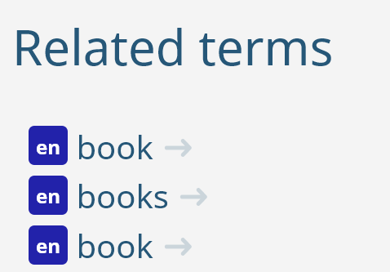
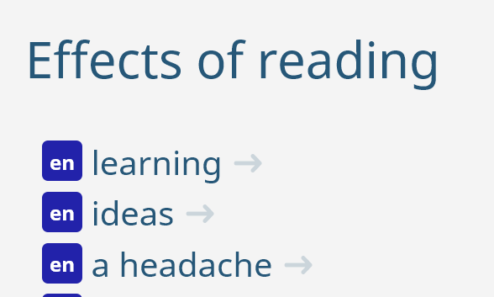
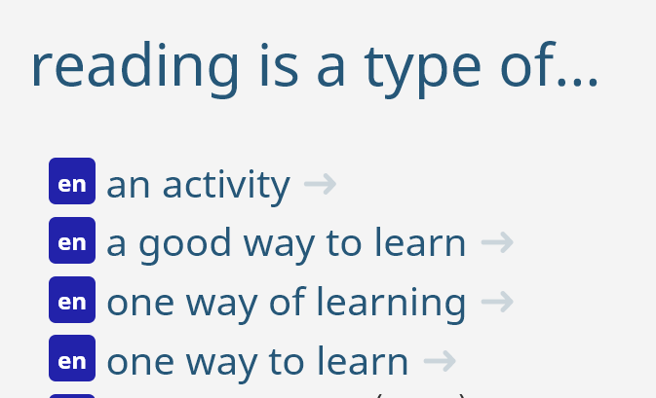
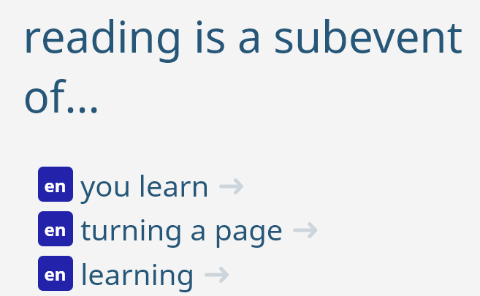

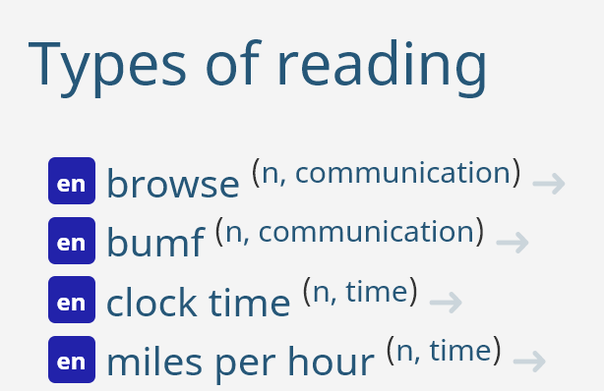
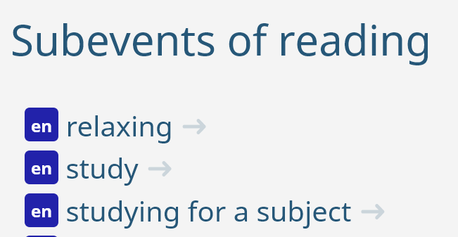
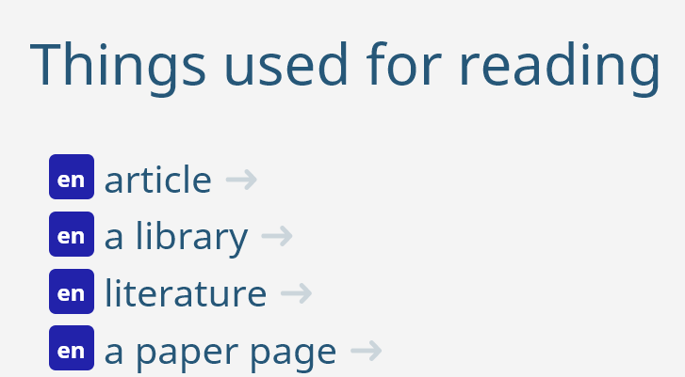

Slide 22
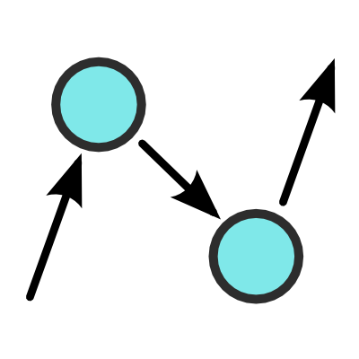
What is ConceptNet?
General commonsense knowledge
21 million edges and over 8 million nodes (as of 2017)
Over 85 languages
In English: over 1.5 million nodes
Knowledge covered:
Open Mind Commonsense assertions
Wikipedia/Wiktionary semantic knowledge
WordNet, Cyc ontological knowledge
http://conceptnet.io/

Slide 23
Atomic: inferential knowledge in natural language form
https://mosaickg.apps.allenai.org/kg_atomic

Slide 24
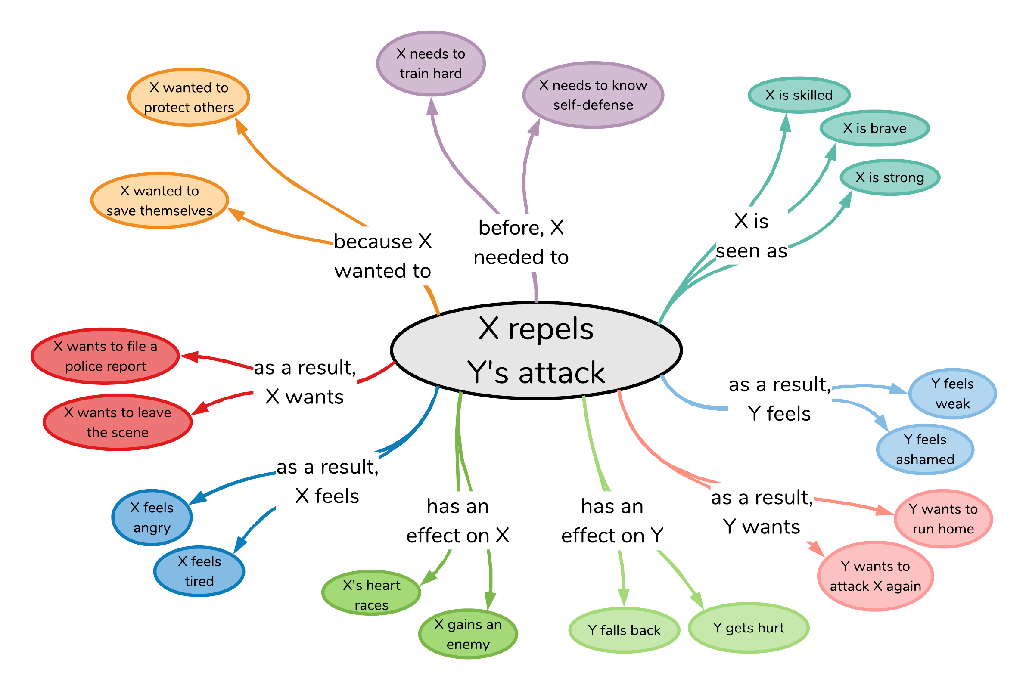

X repels Y’s attack
Atomic: 880,000 triples for AI systems to reason about causes and effects of everyday situations
Notes:
and what I mean by ATLAS is this HUGE knowledge graph that covers knowledge about the causes and effects of everyday situations.
What I mean by this is, given an event like

Slide 25
X repels Y’s attack
Notes:
What I mean by this is, given an event like “X repels Y’s attack”, as humans we have commonsense that allows us to make all sorts of inferences around this situation;
why did it happen? how do participants feel? etc.

Slide 26
nine inference dimensions
X repels Y’s attack
Notes:
ATOMIC distills this type of inferential knowledge into NINE different of knowledge dimensions, shown here around the event.
These dimensions cover knowledge around the CAUSES of the event,

Slide 27

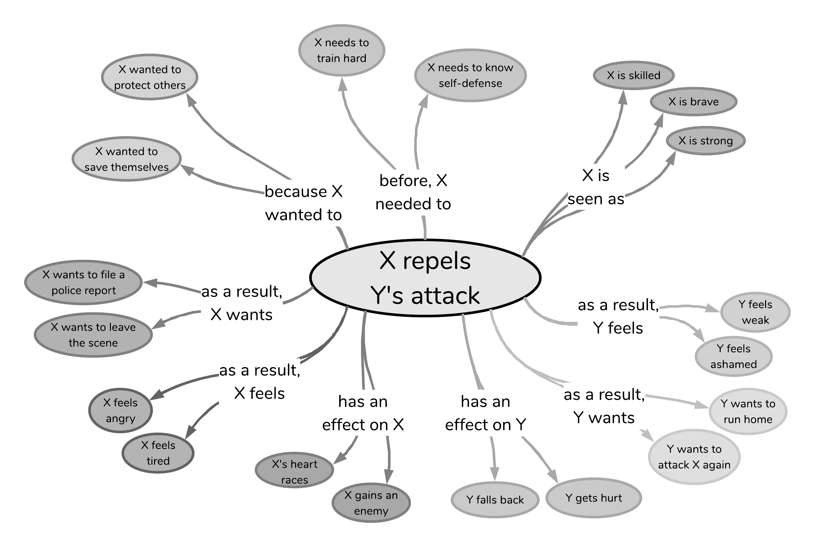
Causes
X repels Y’s attack
Effects
Notes:
These dimensions cover knowledge around the CAUSES of the event, ….
And knowledge around the EFFECTS of the event

Slide 28
Static
Dynamic
X repels Y’s attack
Notes:
In addition to all these dynamic cause and effect inferences humans can make around events,
ATOMIC also covers static knowledge about how event participants are seen or described while the event happens, such as here where X is seen as strong, skilled or brave.

Slide 29
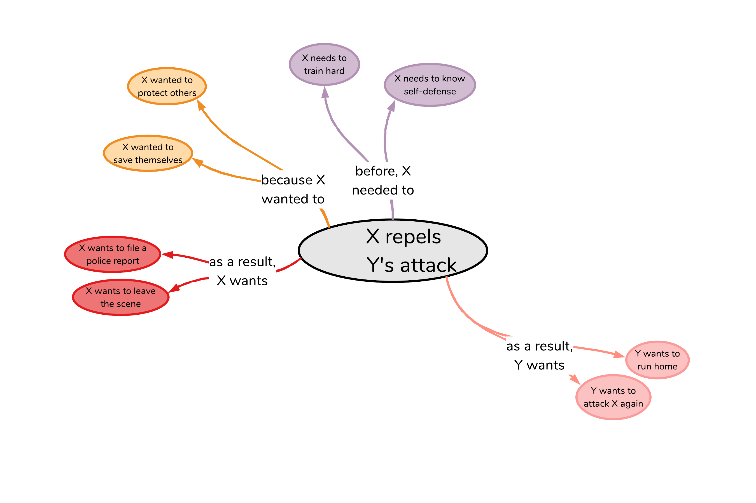
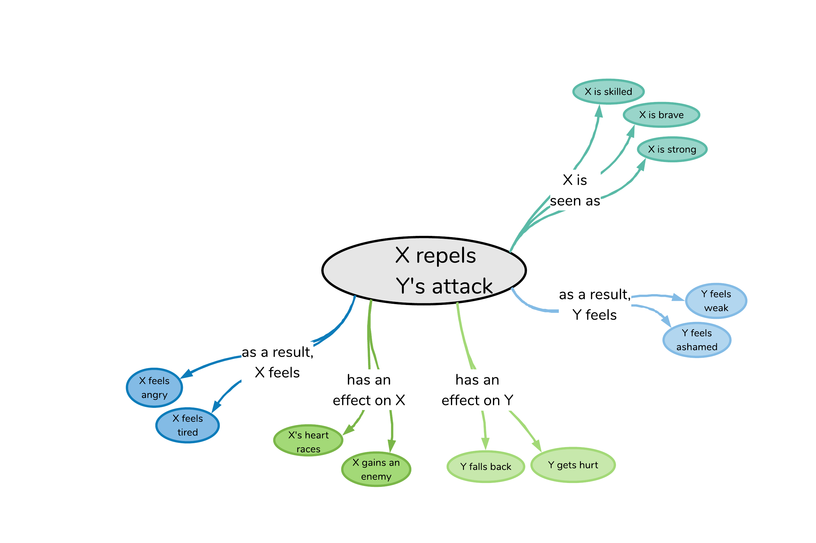
Voluntary
X repels Y’s attack
Involuntary
Notes:
Another way to look at this knowledge is in terms of volitionality.
ATOMIC covers both the more voluntary dimensions, such as what people need or want to do,
As well as more involuntary effects or implications of events, such as people’s reactions or how people are seen.

Slide 30
X repels Y’s attack
Theme
Agent
Notes:
And last but not least, the knowledge in ATOMIC can also be thought about in terms of “what happens to whom”.
So specifically, what inferences can we make about the AGENT of the event, here, X,
Versus what inferences can we make about the THEME of the event, here, Y

Slide 31
300,000 event nodes to date
880,000 if-Event-then-* knowledge triples
X repels Y’s attack
Notes:
All this knowledge is contained in our knowledge graph that, to date, contains OVER 300 THOUSAND event nodes, connected in NEARLY 900 THOUSAND if-Event-then-SOMETHING triples

Slide 32
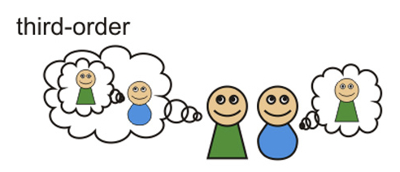

Atomic: knowledge of cause and effect
Theory of Mind
Humans have theory of mind, allowing us to
make inferences about people’s mental states
understand likely events that precede and follow (Moore, 2013)
AI systems struggle with inferential reasoning
only find complex correlational patterns in data
limited to the domain they are trained on
(Pearl; Davis and Marcus 2015; Lake et al. 2017; Marcus 2018)
Notes:
The motivation behind choosing the type of knowledge in ATOMIC

Slide 33
Overview of existing resources
ATOMIC (Sap et al., 2019)
Web Child (Tandon et al., 2014)
Web Child 2.0 (Tandon et al., 2017)
NELL (Carlson et al., 2010)
NELL (Mitchell et al., 2015)
Open Mind Common Sense (Minsky, Singh & Havasi, 1999)
ConceptNet (Liu & Singh, 2004)
ConceptNet 5.5 (Speer et al., 2017)
Cyc (Lenat et al., 1984)
OpenCyc (Lenat, 2004)
ResearchCyc (Lenat, 2006)
OpenCyc 4.0 (Lenat, 2012)
today
Notes:
TODO: Beef this up with bubbles on each resource that isn’t ATOMIC and ConceptNet.
Cyc: Developed in 1984 by Doug Lenat and Alan Kay, the goal was to have machines be able to do human-like commonsense reasoning by learning inference rules. Developed their own LISP-like language to represent facts, developed their ontology of concepts to certain degree of specificity, and created a knowledge base using their language and ontology.
OpenMind Commonsense: More on this later, but this project started in the late 90s early / 2000s, based on the premise that commonsense knowledge can be represented in natural language statements.
Never ending language learner (NELL): This project was started at CMU in 2010s, and operates under a different philosophy of knowledge collection: learn knowledge by reading. The main premise is that given a few hundred types of concepts (people, cities, companies) you will automatically start learning semantic relations between them. For several reasons that I’ll discuss later, there are some drawbacks to this information extraction approach, so they have humans manually correct the automatic inferences just to make sure. (e.g., you can delete your internet cookies, and you can delete your files, and if internet cookies are a type of baked good, then files must also be a type of baked good?)
WebChild: kind of following the NELL framework, WebChild uses automatic information extraction methods for fine-grained noun-adjective relationships, with a specific focus on disambiguating the senses of words (e.g., the word hot could be temperature or a taste). In WebChild 2.0 they added the “activities” or verbs as a data type to their knowledge base.
ATOMIC: also discuss this in further detail, but this knowledge graph was designed in a similar spirit to Open Mind Commonsense / ConceptNet (i.e., using natural language representations), but focusing on a different type of commonsense knowledge.

Slide 34
Existing knowledge bases
ATOMIC (Sap et al., 2019)
NELL (Mitchell et al., 2015)
ConceptNet 5.5 (Speer et al., 2017)
OpenCyc 4.0 (Lenat, 2012)

Slide 35
Existing knowledge bases
Represented in symbolic logic
(e.g., LISP-style logic)
Represented in natural language
(how humans talk and think)
NELL (Mitchell et al., 2015)
OpenCyc 4.0 (Lenat, 2012)
ConceptNet 5.5 (Speer et al., 2017)
ATOMIC (Sap et al., 2019)
(#$implies
(#$and
(#$isa ?OBJ ?SUBSET)
(#$genls ?SUBSET ?SUPERSET))
(#$isa ?OBJ ?SUPERSET))

Slide 36
Existing knowledge bases
Represented in symbolic logic
(e.g., LISP-style logic)
Represented in natural language
(how humans talk and think)
NELL (Mitchell et al., 2015)
OpenCyc 4.0 (Lenat, 2012)
ConceptNet 5.5 (Speer et al., 2017)
Knowledge of “what” (taxonomic: A isA B)
Knowledge of “why” and “how”
(inferential: causes and effects)
ATOMIC (Sap et al., 2019)

Slide 37
Q: How do you gather commonsense knowledge at scale?
A: It depends on the type of knowledge
Notes:
Section: How do you actually gather knowledge?
Pros of extracting from text: People start by trying to find them in text (cite). this can be very powerful, explain some IE type pipeline.
Con of extracting from text: Reporting bias!! Show example
Alternative: Experts create knowledge: Cyc, WordNet, etc. pros: it’s good quality, you can use specific representations (e.g., CycL, Gordon & Hobbs). cons:
Alternative: Non-expert humans in the loop / crowdsourcing! (that’s what ATOMIC & ConceptNet did)

Slide 38
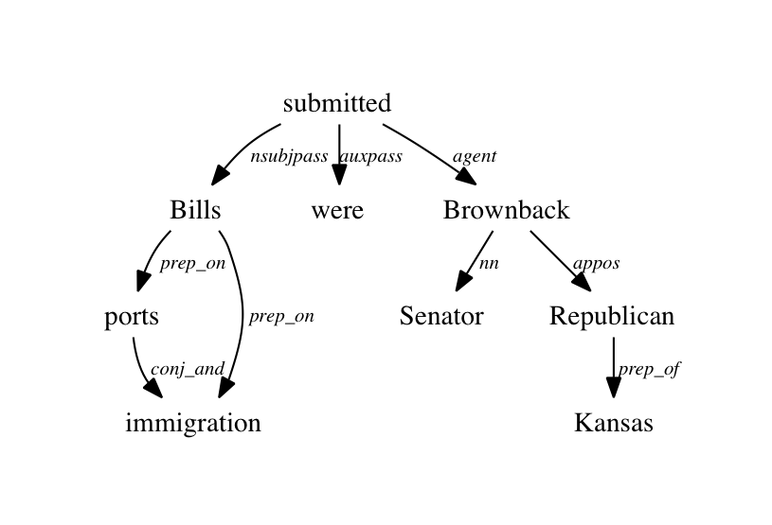
Extracting commonsense from text
Based on information extraction (IE) methods
Read and parse text
Create candidate rules
Filter rules based on quality metric
Advantage: can extract knowledge automatically
Example system: Never Ending Language Learner (NELL; Carlson et al., 2010)
isA(senator,Brownback)
location(Kansas,Brownback)
isA(senator,Kansas)
...
Notes:
What kind of knowledge can we extract from text?

Slide 39



Some commonsense cannot be extracted
Text is subject to reporting bias (Gordon & Van Durme, 2013)
Noteworthy events
Murdering 4x more common than exhaling
Commonsense is not often written
Grice’s maxim of quantity
found when extracting commonsense knowledge on four large corpora using Knext (Gordon & Van Durme, 2013)
When communicating, people try to be as informative as they possibly can, and give as much information as is needed, and no more.
Notes:
Sync the animations better so that the exhaling only appears as

Slide 40
Eliciting commonsense from humans
Experts create knowledge base
Non-experts write knowledge in natural language phrases
Advantages:
Quality guaranteed
Can use complex representations (e.g., CycL, LISP)
Drawbacks:
Time cost
Training users
Natural language
Accessible to non-experts
Different phrasings allow for more nuanced knowledge
Fast and scalable collection
Crowdsourcing
Games with a purpose
OpenCyc 4.0 (Lenat, 2012)
WordNet (Miller et al., 1990)
ATOMIC (Sap et al., 2019)
ConceptNet 5.5 (Speer et al., 2017)

Slide 41



Examples of machine inferences (2)
PersonX wins the title
As a result, X wants to
As a result, Y feels
celebrate
brag
congratulate themselves
celebrate their achievement
celebrate the event
celebrate with the team
happy
jealous
competitive
impressed
defeated
proud of PersonX
Infer effects on implied participants
be the best
dominate the competition
celebrate
happy that PersonX won
desire to work harder
Notes:
Possible use as example of multiple interpretations

Slide 42
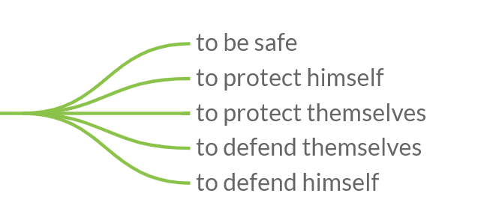
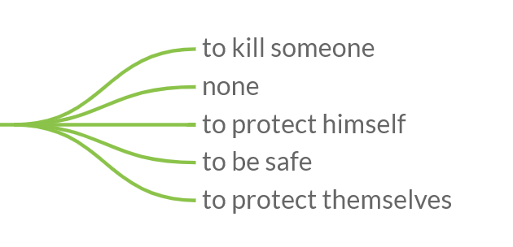
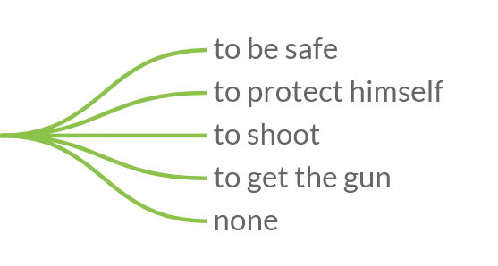
Knowledge bases and mitigating biases
PersonX clutches a gun
because X wanted to
ATOMIC (Sap et al., 2019)
Jaquain clutches a gun
because X wanted to
Karen clutches a gun
because X wanted to
COMET (Bosselut et al., 2019): ATOMIC + OpenAI GPT
Notes:
COMET adds a pre-trained language model to ATOMIC
Different data collection methods suffer from social biases differently

Slide 43
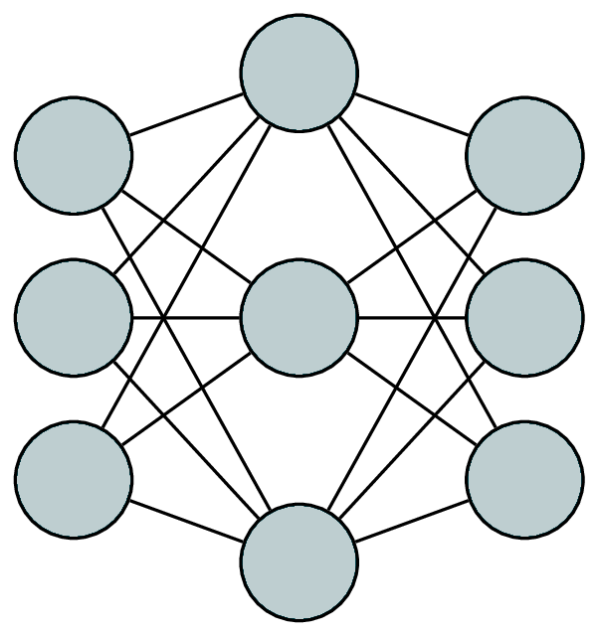
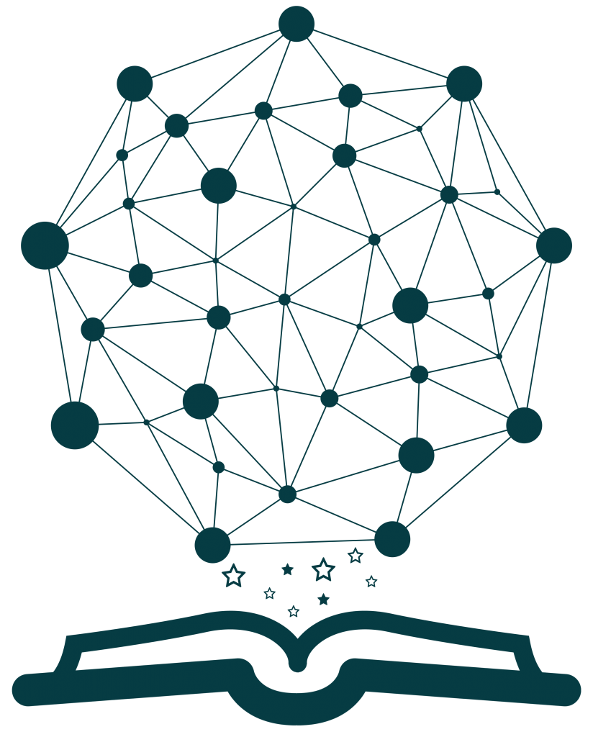
Neural and Symbolic Models of Commonsense Reasoning

Slide 44

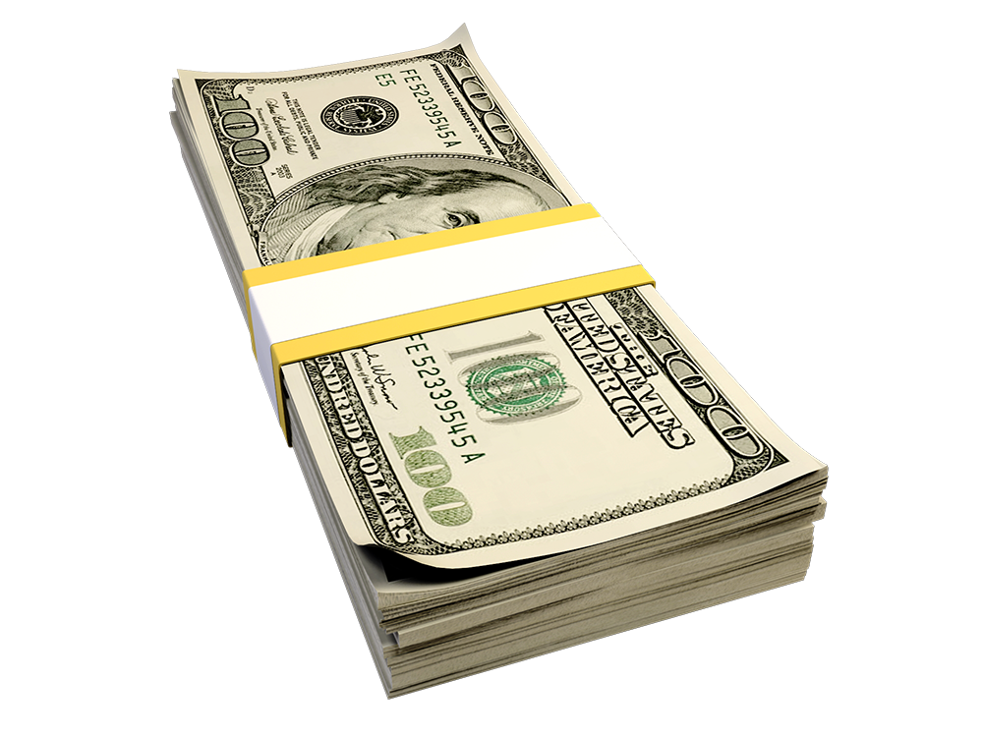

Katrina had the financial means to afford a new car while Monica did not, since had a high paying job.
WINOGRANDE: An Adversarial Winograd Schema Challenge at Scale. Keisuke Sakaguchi, Ronan Le Bras, Chandra Bhagavatula, and Yejin Choi. AAAI 2020.

Slide 45

Neural Architecture
[CLS] Katrina had the financial means to afford a new car while Monica did not, since [SEP] Katrina had a high paying job.
0.51
[CLS] Katrina had the financial means to afford a new car while Monica did not, since [SEP] Monica had a high paying job.
0.49

Slide 46
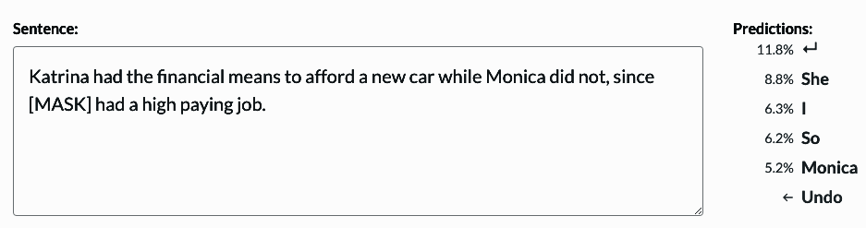
Masked Language Models
https://demo.allennlp.org/masked-lm
Notes:
Fine Tuning is very important. Monica is not the correct answers.

Slide 47

job
is used for
make money
entails
make a lot of money
is used for
type of
requires
requires
high-paying job
spend money
entails
spend a lot of money
requires
requires
buy
entails
buy something that costs a lot of money
x
something to
something to
car
is capable of
cost a lot of money
http://conceptnet5.media.mit.edu/

Slide 48
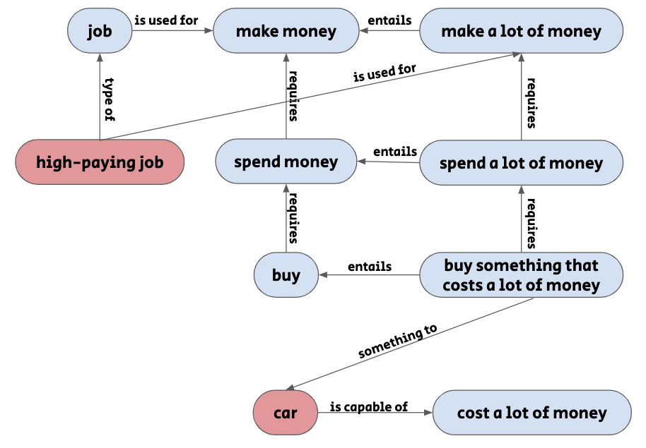
Incorporating External Knowledge into Neural Models
General Idea
0.57
0.43
Model
vector representation
Katrina had the financial means to afford a new car while Monica did not, since ____ had a high paying job.

Slide 49

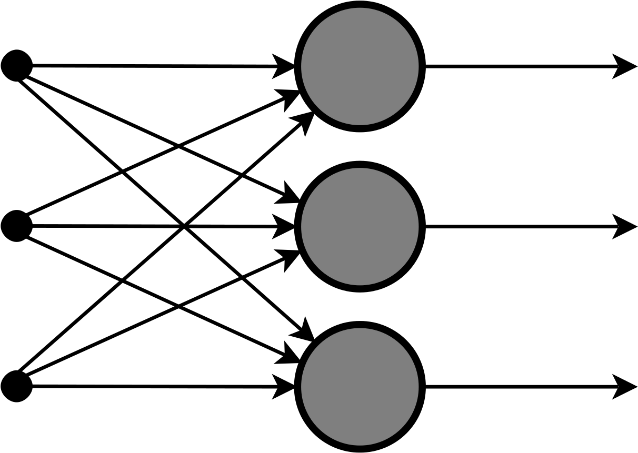


Incorporating External Knowledge into Neural Models
Recipe
Task
Neural Component
Story ending, Machine Comprehension Social common sense NLI
Pre/post pre-trained language models
Knowledge Source
Combination Method
Attention, pruning, word embeddings, multi-task learning
Knowledge bases, extracted from text, hand-crafted rules

Slide 50
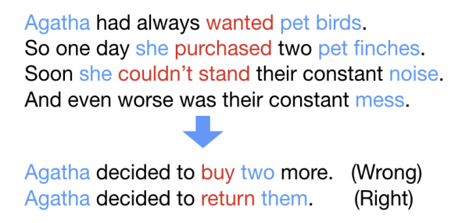
Story Ending Task (RocStories)
Task
A Corpus and Cloze Evaluation for Deeper Understanding of Commonsense Stories. Nasrin Mostafazadeh, Nathanael Chambers, Xiaodong He, Devi Parikh, Dhruv Batra, Lucy Vanderwende, Pushmeet Kohli, and James Allen. NAACL 2016.

Slide 51
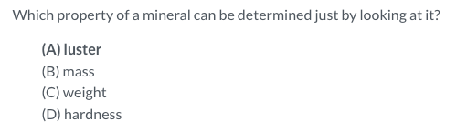
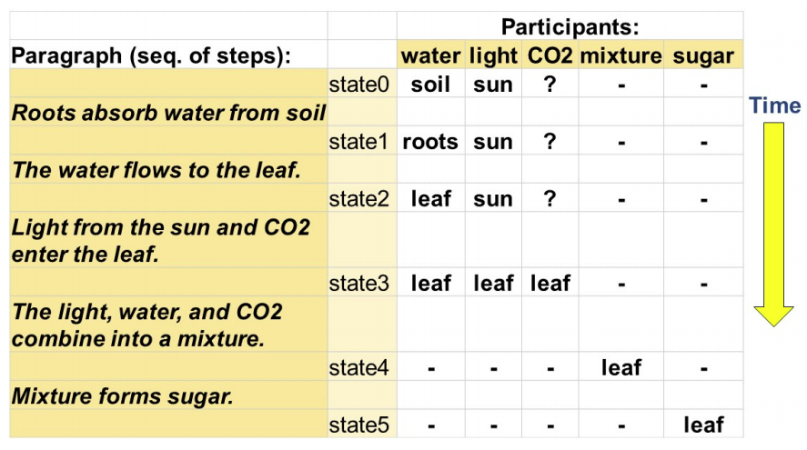
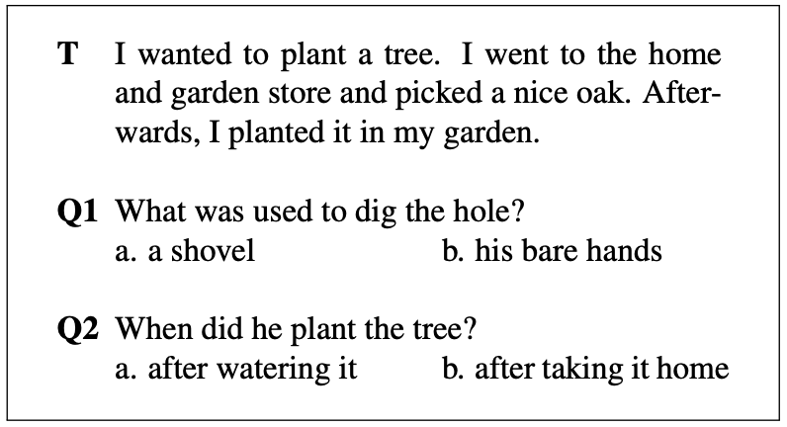
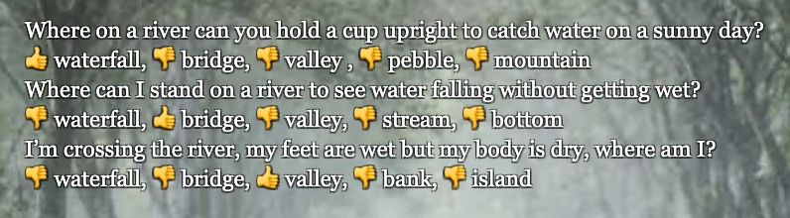
Machine Comprehension Tasks
ARC
ProPara
MCScript
NarrativeQA
Question: How is Oscar related to Dana? Answer: her son Snippet: [...] She continues digging in her purse while Frank leans over the buggy and makes funny faces at the baby, OSCAR, a very cute nine-month old boy. [...]
Task
CommonsenseQA
Notes:
ProPara = related to change of states in entities
Narrative QA = question answering about stories
MC Scripts = Machine comprehension of scripts
ARC = AI2 Reasoning Challenge
Common Sense QA = commonsense question answering, asks general commonsense questions about qusestions.

Slide 52
Knowledge Source
ATOMIC (Sap et al., 2019)
Web Child (Tandon et al., 2014)
Web Child 2.0 (Tandon et al., 2017)
NELL (Carlson et al., 2010)
NELL (Mitchell et al., 2015)
Open Mind Common Sense (Minsky, Singh & Havasi, 1999)
ConceptNet (Liu & Singh, 2004)
ConceptNet 5.5 (Speer et al., 2017)
Cyc (Lenat et al., 1984)
OpenCyc (Lenat, 2004)
ResearchCyc (Lenat, 2006)
OpenCyc 4.0 (Lenat, 2012)
today
Notes:
TODO: Beef this up with bubbles on each resource that isn’t ATOMIC and ConceptNet.
Cyc: Developed in 1984 by Doug Lenat and Alan Kay, the goal was to have machines be able to do human-like commonsense reasoning by learning inference rules. Developed their own LISP-like language to represent facts, developed their ontology of concepts to certain degree of specificity, and created a knowledge base using their language and ontology.
OpenMind Commonsense: More on this later, but this project started in the late 90s early / 2000s, based on the premise that commonsense knowledge can be represented in natural language statements.
Never ending language learner (NELL): This project was started at CMU in 2010s, and operates under a different philosophy of knowledge collection: learn knowledge by reading. The main premise is that given a few hundred types of concepts (people, cities, companies) you will automatically start learning semantic relations between them. For several reasons that I’ll discuss later, there are some drawbacks to this information extraction approach, so they have humans manually correct the automatic inferences just to make sure. (e.g., you can delete your internet cookies, and you can delete your files, and if internet cookies are a type of baked good, then files must also be a type of baked good?)
WebChild: kind of following the NELL framework, WebChild uses automatic information extraction methods for fine-grained noun-adjective relationships, with a specific focus on disambiguating the senses of words (e.g., the word hot could be temperature or a taste). In WebChild 2.0 they added the “activities” or verbs as a data type to their knowledge base.
ATOMIC: also discuss this in further detail, but this knowledge graph was designed in a similar spirit to Open Mind Commonsense / ConceptNet (i.e., using natural language representations), but focusing on a different type of commonsense knowledge.

Slide 53
ConceptNet
job
is used for
make money
requires
spend money
requires
buy
something to
cost a lot of money
is capable of
car
Conceptnet 5.5: An open multilingual graph of general knowledge. Robyn Speer, Joshua Chin, and Catherine Havasi. AAAI 2017.

Slide 54
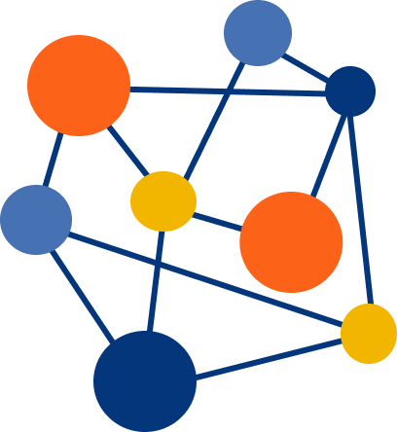


Knowledge Bases
Mining from Text
Tools
Other Knowledge Sources
Other Knowledge Sources
WordNet
SentiWordNet
ATOMIC
Mining script knowledge from corpora, event plausibility from corpora
Knowledge base embeddings, sentiment analysis models, COMET

Slide 55
Neural Component
[CLS] Katrina had the financial means to afford a new car while Monica did not, since [SEP] Katrina had a high paying job.
0.51
[CLS] Katrina had the financial means to afford a new car while Monica did not, since [SEP] Monica had a high paying job.
0.49

Slide 56
Combination Method
Incorporate into scoring function
Symbolic → vector representation
(+attention)
Multi-task learning

Slide 57
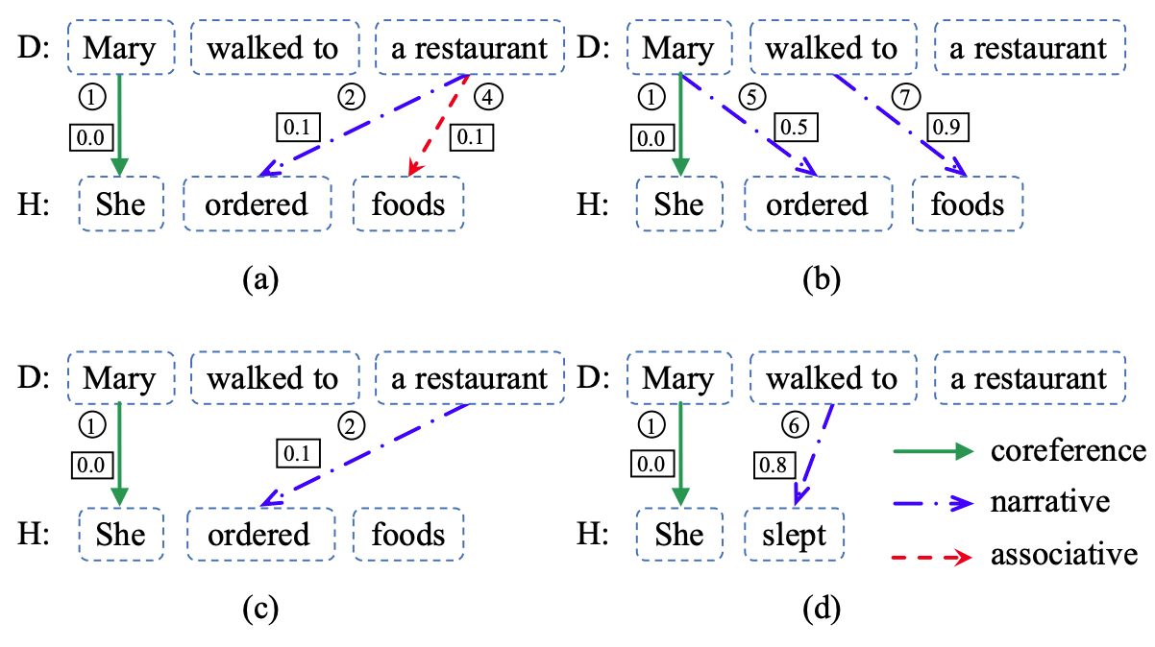
Incorporating External Knowledge into Neural Models
Example #1
1. For each sentence in the story (premise), find a set of inference rules that “cover” a story ending (hypothesis): reason.
RocStories
Inference Rules (with costs)
WordNet: restaurant→eatery (1.0)
Wikipedia: restaurant→business (1.0)
Script knowledge: X went to a restaurant→X ate (0.32)
Relatedness: restaurant→food (0.71)
Hand-crafted negation rules
Sentiment
...
2. Learn to score a reason according to costs, inference types, and relatedness between the involved words, using attention mechanism.
3. Aggregate across all the sentences in the story.
Reasoning with Heterogeneous Knowledge for Commonsense Machine Comprehension. Hongyu Lin, Le Sun, and Xianpei Han. EMNLP 2017

Slide 58
Incorporating External Knowledge into Neural Models
Example
[CLS] Story: s1 … sn ... [SEP] Ending 1: e11, … , e1k
0.51
RocStories
MCScript
[CLS] Story: s1 … sn ... [SEP] Ending 2: e21, … , e2l
0.49
Multi-task Learning
Si = restaurant
Ej = food
ConceptNet
1. Are they related?
2. What’s the relation?
yes
Aux Classifier 1
Aux Classifier 2
serve
restaurant
food
restaurant
food
Incorporating Commonsense Reading Comprehension with Multi-task Learning. Jiangnan Xia, Chen Wu, and Ming Yan. CIKM 2019.

Slide 59
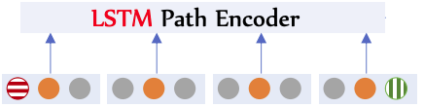
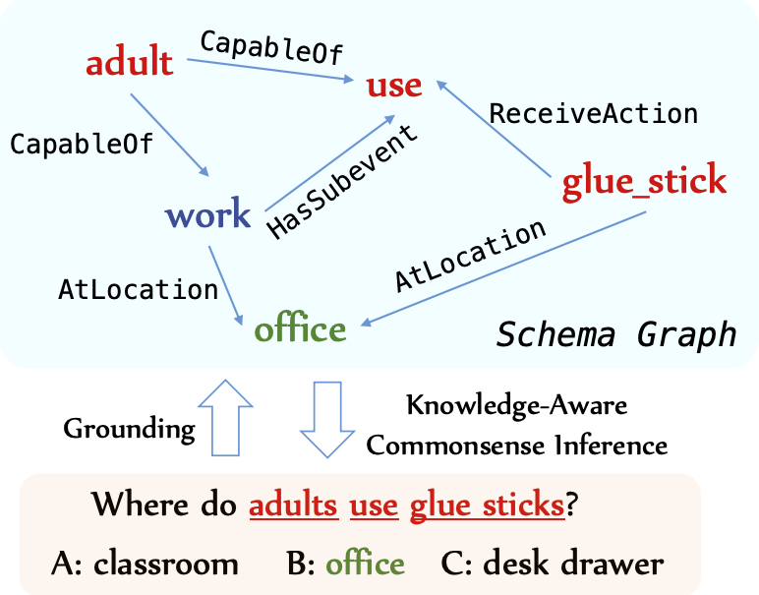
Incorporating External Knowledge into Neural Models
Example #3
CommonsenseQA
[CLS] Where do adults use glue sticks? [SEP] office
Statement Vector
ConceptNet
+ Attention →
Graph Vector
MLP
Statement Vector
Graph Vector
1. Retrieving subgraphs. 2. Pruning
KagNet: Knowledge-Aware Graph Networks for Commonsense Reasoning. Bill Yuchen Lin, Xinyue Chen, Jamin Chen, Xiang Ren. EMNLP 2019.

Slide 60
Limitations
Insufficient Coverage
Not 100% accurate
knowledge In KBs
person
factual world knowledge
type of
type of
type of
job
Monica
Easy to incorporate simple resources with stationary facts (ConceptNet) but they are limited in expressiveness:
gentleman
located at
restaurant

Slide 61
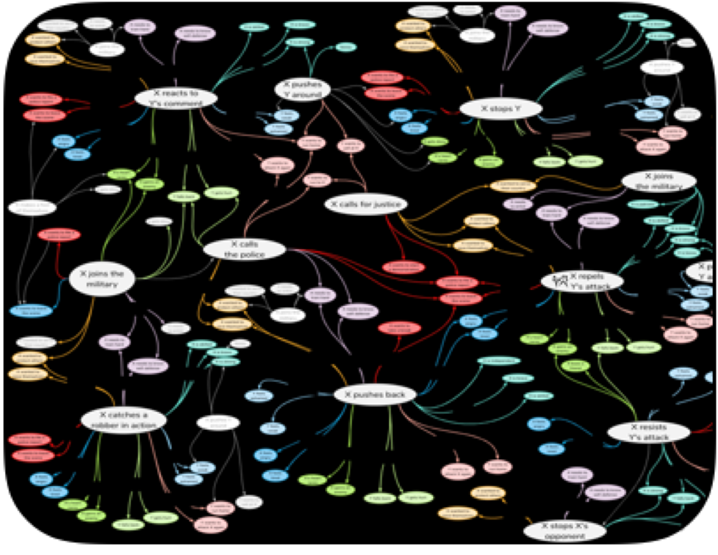
Limitations of Knowledge Graphs
Insufficient Coverage
Not 100% Accurate
Limited expressivity

Slide 62
Limitations of Knowledge Graphs
Kai knew that things were getting out of control and managed to keep his temper in check

Slide 63
Limitations of Knowledge Graphs
Situations rarely found as-is in commonsense knowledge graphs
ATOMIC
(X goes to the mall, Effect on X, buys clothes)
(X goes the mall, Perception of X, rich)
(X gives Y some money, Reaction of Y, grateful)
(Sap et al., 2019)

Slide 64
Limitations of Knowledge Graphs
Situations rarely found as-is in commonsense knowledge graphs
Connecting to knowledge graphs can yield incorrect nodes
X keeps X’s temper
Kai knew that things were getting out of control and managed to keep his temper in check
X keeps ___ under control
X keeps X's ___ in check
64

Slide 65
Limitations of Knowledge Graphs
Situations rarely found as-is in commonsense knowledge graphs
Connecting to knowledge graphs can yield incorrect nodes
Suitable nodes are often uncontextualized
X keeps X’s temper
X sweats
Kai knew that things were getting out of control and managed to keep his temper in check
X keeps ___ under control
X wants to show strength
X keeps X's ___ in check
X avoids a fight

Slide 66
Limitations of Knowledge Graphs
Situations rarely found as-is in commonsense knowledge graphs
Connecting to knowledge graphs can yield incorrect nodes
Suitable nodes are often uncontextualized
X keeps X’s temper
X sweats
Kai knew that things were getting out of control and managed to keep his temper in check
X keeps ___ under control
X wants to show strength
X keeps X's ___ in check
X avoids a fight

Slide 67
Challenge
How do we provide machines with large-scale commonsense knowledge?

Slide 68


Constructing Knowledge Graphs
Write commonsense knowledge facts
Store facts in knowledge graph
Observe world
(person, CapableOf, start school)
(person, CapableOf, start school)
(person, CapableOf, start school)
(person, CapableOf, start school)
(person, CapableOf, start school)
(person, CapableOf, start school)
(person, CapableOf, start school)
(person, CapableOf, start school)
(person, CapableOf, start school)
(person, CapableOf, start school)
(person, CapableOf, start school)
(person, CapableOf, start school)
(person, CapableOf, start school)
(person, CapableOf, start school)
(person, CapableOf, buy)

Slide 69



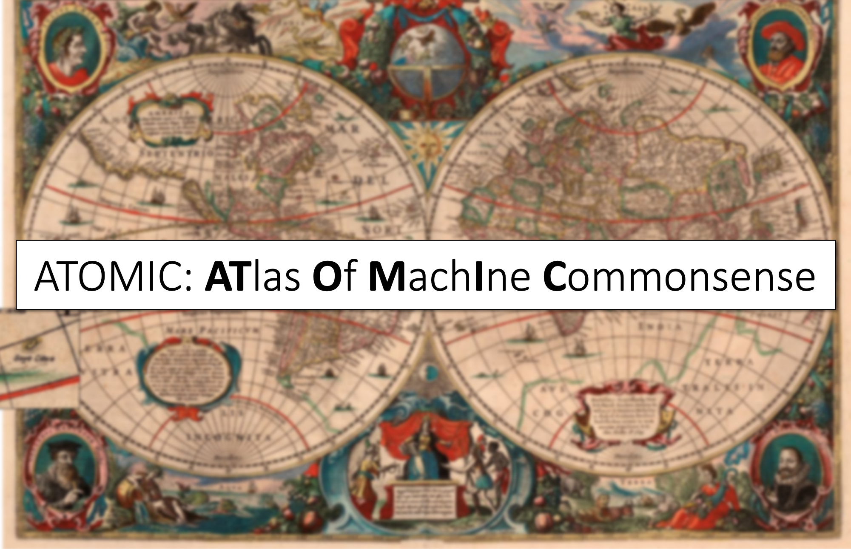
Constructing Symbolic Knowledge Graphs
Write commonsense knowledge facts
Store facts in knowledge graph
Observe world
(person, CapableOf, start school)
(person, CapableOf, start school)
(person, CapableOf, start school)
(person, CapableOf, start school)
(person, CapableOf, start school)
(person, CapableOf, start school)
(person, CapableOf, start school)
(person, CapableOf, start school)
(person, CapableOf, start school)
(person, CapableOf, start school)
(person, CapableOf, start school)
(person, CapableOf, start school)
(person, CapableOf, start school)
(person, CapableOf, start school)
(person, CapableOf, buy)
(Miller, 1995)
(Singh et al., 2002)
(Lenat, 1995)
(Sap et al., 2019)

Slide 70
Challenges of Prior Approaches
Commonsense knowledge is immeasurably vast, making it impossible to manually enumerate

Slide 71

Constructing Knowledge Graphs Automatically
Gather Textual Corpus
Automatically extract knowledge
Store in knowledge graph
John went to the grocery store to buy some steaks. He was going to prepare dinner for his daughter’s birthday. She was turning 5 and would be starting elementary school soon.
(person, CapableOf, start school)
(person, CapableOf, start school)
(person, CapableOf, start school)
(person, CapableOf, start school)
(person, CapableOf, start school)
(person, CapableOf, start school)
(person, CapableOf, start school)
(person, CapableOf, start school)
(person, CapableOf, start school)
(person, CapableOf, start school)
(person, CapableOf, start school)
(person, CapableOf, start school)
(person, CapableOf, start school)
(person, CapableOf, start school)
(person, CapableOf, buy)
(Schubert, 2002)
(Banko et al., 2007)
(Zhang et al., 2020)
Webchild
(Speer et al., 2017)
(Tandon et al., 2019)

Slide 72
Encyclopedic vs. Commonsense Knowledge
Encyclopedic Knowledge | Commonsense Knowledge
Explicitly written in text Ontological Mentions Deviations rarely written | Often assumed
Grice’s Maxim of Quantity

Slide 73
Encyclopedic vs. Commonsense Knowledge
Encyclopedic Knowledge | Commonsense Knowledge
Explicitly written in text Ontological Mentions Deviations rarely written | Often assumed Complex Mentions
Grice’s Maxim of Quantity
e.g., Causal If-Then Knowledge

Slide 74
Encyclopedic vs. Commonsense Knowledge
Encyclopedic Knowledge | Commonsense Knowledge
Explicitly written in text Ontological Mentions Deviations rarely written | Often assumed Complex Mentions Reporting Bias
Grice’s Maxim of Quantity
e.g., Causal If-Then Knowledge
murders 4x more common than breating

Slide 75
Challenges of Prior Approaches
Commonsense knowledge is immeasurably vast, making it impossible to manually enumerate
Commonsense knowledge is often implicit, and often can’t be directly extracted from text

Slide 76
Constructing Knowledge Graphs Automatically
Gather Textual Corpus
Automatically extract knowledge
Store in knowledge graph
John went to the grocery store to buy some steaks. He was going to prepare dinner for his daughter’s birthday. She was turning 5 and would be starting elementary school soon.
(person, CapableOf, start school)
(person, CapableOf, start school)
(person, CapableOf, start school)
(person, CapableOf, start school)
(person, CapableOf, start school)
(person, CapableOf, start school)
(person, CapableOf, start school)
(person, CapableOf, start school)
(person, CapableOf, start school)
(person, CapableOf, start school)
(person, CapableOf, start school)
(person, CapableOf, start school)
(person, CapableOf, start school)
(person, CapableOf, start school)
(person, CapableOf, buy)
(Schubert, 2002)
(Banko et al., 2007)
(Zhang et al., 2020)
Webchild
(Speer et al., 2017)
(Tandon et al., 2019)

Slide 77
Knowledge Base Completion
Gather training set of knowledge tuples
Learn relationships among entities
Predict new relationships
Store in knowledge graph
(person, CapableOf, start school)
(person, CapableOf, start school)
(person, CapableOf, start school)
(person, CapableOf, start school)
(person, CapableOf, start school)
(person, CapableOf, start school)
?
(person, CapableOf, start school)
(person, CapableOf, )
(person, CapableOf, start school)
(person, CapableOf, start school)
(person, CapableOf, start school)
(person, CapableOf, start school)
(person, CapableOf, start school)
(person, CapableOf, start school)
(person, CapableOf, start school)
(person, CapableOf, buy)
(Socher et al., 2013)
(Bordes et al., 2013)
(Riedel et al., 2013)
(Toutanova et al., 2015)
(Yang et al., 2015)
(Trouillon et al., 2016)
(Nguyen et al., 2016)
(Dettmers et al., 2018)

Slide 78
Commonsense Knowledge Base Completion
True / False
Only high confidence predictions are validated
Bilinear Model
Linear
Linear
Low Novelty
( person, CapableOf, buy )
head
entity
relation
tail
entity
Li et al., 2016
Jastrzebski et al., 2018

Slide 79
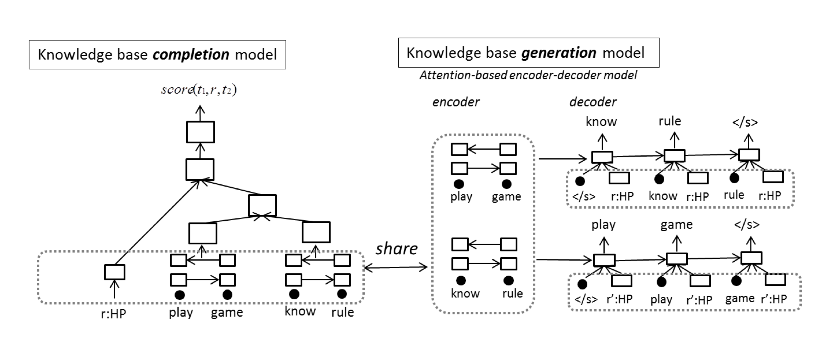
Commonsense Knowledge Base Completion and Generation!
Saito et al., 2018

Slide 80
Challenges of Prior Approaches
Commonsense knowledge is immeasurably vast, making it impossible to manually enumerate
Commonsense knowledge is often implicit, and often can’t be directly extracted from text
Commonsense knowledge resources are quite sparse, making them difficult to extend by only learning from examples

Slide 81
Solution Outline
Leverage manually curated commonsense knowledge resources
Learn from the examples to induce new relationships
Scale up using language resources
Learn word embeddings
from language corpus
Retrofit word embeddings
on semantic resource
Learn knowledge-
aware embeddings
Faruqui et al., 2015, Speer et al., 2017

Slide 82
Transformer Language Models
sailed
across
oceans
in
bought
a
boat
<END>
Predict Next Word
Output
Output
Output
Output
Output
Output
Output
}
Output
Block
Block
Block
Block
Block
Block
Block
Block
Stacked Transformer Blocks
…
…
…
Block
Block
Block
Block
Block
Block
Block
Block
Input Vector
h0
h1
h2
h3
hT-3
hT-2
hT-1
hT
Allen
sailed
across
oceans
He
bought
a
boat
(Radford et al., 2018, 2019)

Slide 83
Learning in Language Models
Text Corpus
Transformer Language Model
Used to
Learn
(Radford et al., 2018, 2019)

Slide 84
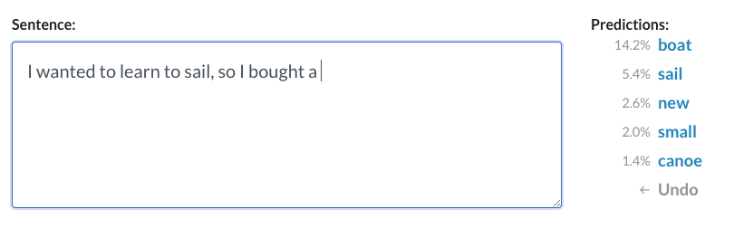
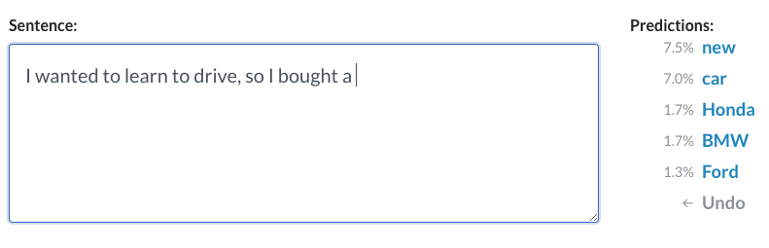
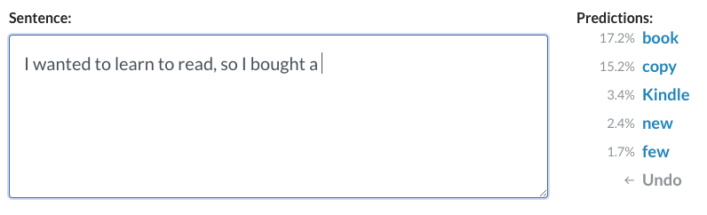
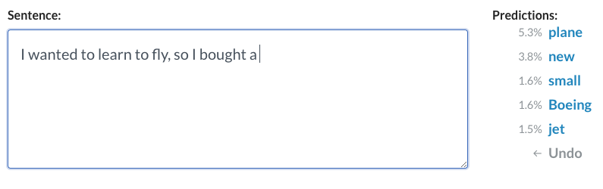
Knowledge in Language Models
https://demo.allennlp.org/next-token-lm

Slide 85
From Unstructured to Structured Knowledge
Transformer Language Model
Used to
?
Generate

Slide 86
Transformer Language Models
sailed
across
oceans
in
…
bought
a
boat
<END>
Output
Output
Output
Output
Output
Output
Output
Output
Block
Block
Block
Block
Block
Block
Block
Block
…
Block
Block
Block
Block
Block
Block
Block
Block
Block
Block
Block
Block
Block
Block
Block
Block
Input
Input
Input
Input
Input
Input
Input
Input
Allen
sailed
across
oceans
…
He
bought
a
boat
(Radford et al., 2018, 2019)

Slide 87
Transformer Language Models
Trained to generate the next word given a set of preceding words
sailed
across
oceans
in
…
bought
a
boat
<END>
Language Model
Allen
sailed
across
oceans
…
He
bought
a
boat

Slide 88
Structure of Knowledge Tuple
relation
<requires>
person
sails
buy
a
boat
across
oceans
head entity
tail entity
(entity to generate)

Slide 89
Learning Structure of Knowledge
Given a seed entity and a relation, learn to generate the target entity
$$ℒ=−∑logP(\text{target} \text{words}|\text{seed} \text{words}\text{, }\text{relation})$$
tail entity
a
boat
buy
Language Model
person
sails
across
oceans
<requires>
head entity
relation
(Bosselut et al., 2019)

Slide 90
Learning Structure of Knowledge
Language Model Knowledge Model: generates knowledge of the structure of the examples used for training
tail entity
a
boat
buy
Knowledge Model
person
sails
across
oceans
<requires>
head entity
relation
(Bosselut et al., 2019)

Slide 91
Generate commonsense
knowledge for any input concept
COMmonsEnse Transformers

Slide 92
COMET - ATOMIC
X perceived as
smart
Before, X needed
to be a teacher
PersonX gives
a tutorial
Others will want
gain knowledge
to thank PersonX
Others then

Slide 93
COMET - ConceptNet
location
classroom
motivated by
you be smart
listen to tutorial
starts with
sit down
has prerequisite
listen carefully
causes
good grade

Slide 94
Question
Why does this work?

Slide 95
Transfer Learning from Language
is a
mango
fruit

Slide 96
Transfer Learning from Language
is a
mango
fruit
ConceptNet
used for
mango
salsa

Slide 97
Transfer Learning from Language
is a
mango
fruit
ConceptNet
used for
mango
salsa
is a
Same Model, Not Pretrained on language
?
mango

Slide 98
Transfer Learning from Language
is a
mango
fruit
ConceptNet
used for
mango
salsa
is a
Same Model, Not Pretrained on language
mango
spice

Slide 99
Question
Can’t a language model
do the same thing?

Slide 100
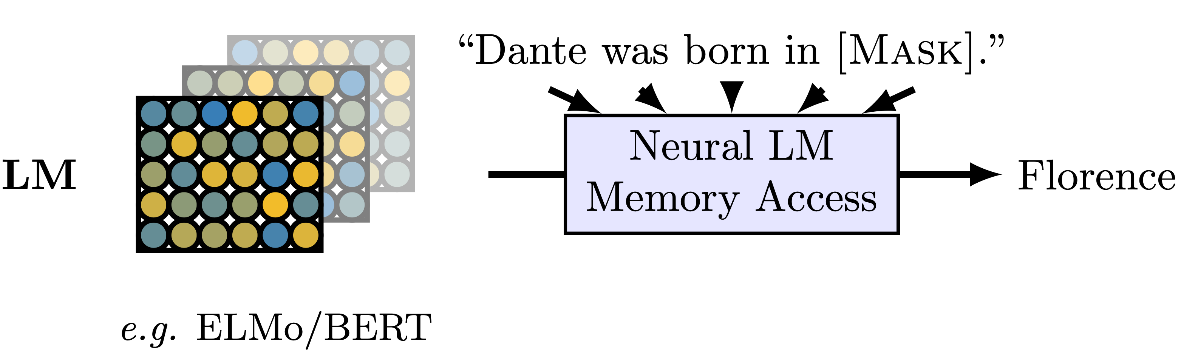
Unsupervised Commonsense Probing
( Dante, <born_in>, ? )
map relation to one or more
natural language sentences
Petroni et al., 2019; Feldman et al., 2019

Slide 101
Do Language Models know this?
https://demo.allennlp.org/next-token-lm

Slide 102
Do Language Models know this?
https://demo.allennlp.org/next-token-lm

Slide 103
Do Language Models know this?
https://demo.allennlp.org/next-token-lm

Slide 104
Do Masked Language Models know this?
https://demo.allennlp.org/masked-lm

Slide 105
Sensitivity to cues
Feldman et al., 2019
Weir et al., 2020

Slide 106
Commonsense Transformers
Language models implicitly represent knowledge
Pre-trained Language Model

Slide 107
Commonsense Transformers
Language models implicitly represent knowledge
Re-train them on knowledge graphs to learn structure of knowledge
+
Pre-trained Language Model
Seed Knowledge
Graph Training

Slide 108
Commonsense Transformers
Language models implicitly represent knowledge
Re-train them on knowledge graphs to learn structure of knowledge
Resulting knowledge model generalizes structure to other concepts
+
=
Pre-trained Language Model
Seed Knowledge
Graph Training
COMET

Slide 109
Question
What are the implications of
this knowledge representation?

Slide 110
Commonsense Knowledge for any Situation
transformer-style architecture — input format is natural language
event can be fully parsed
Kai knew that things were getting out of control and managed to keep his temper in check

Slide 111
Commonsense Knowledge for any Situation
transformer-style architecture — input format is natural language
event can be fully parsed
knowledge generated dynamically from neural knowledge model
Kai wants to avoid trouble
Kai intends to be calm
Kai stays calm
Kai is viewed as cautious
Kai knew that things were getting out of control and managed to keep his temper in check

Slide 112
Reasoning with Knowledge Graphs
X keeps X’s temper
X buys ____
X sweats
X buys ____
Kai knew that things were getting out of control and managed to keep his temper in check
X keeps ___ under control
X wants to show strength
X buys ____
X buys ____
X keeps X's ___ in check
X avoids a fight
X buys ____

Slide 113
Commonsense Knowledge for any Situation
transformer-style architecture — input format is natural language
event can be fully parsed
Kai wants to avoid trouble
Kai intends to be calm
Kai stays calm
Kai is viewed as cautious
Kai knew that things were getting out of control and managed to keep his temper in check

Slide 114
Commonsense Knowledge for any Situation
transformer-style architecture — input format is natural language
event can be fully parsed
dynamically generated knowledge passed to downstream model
Liu et al., 2020

Slide 115
Commonsense Knowledge for any Situation
Chakrabarty et al., 2020

Slide 116
Commonsense Knowledge for any Situation
Kearns et al., 2020

Slide 117

Commonsense Knowledge for any Situation
transformer-style architecture — input format is natural language
event can be fully parsed
knowledge representations passed to downstream model
Bhagavatula et al., 2020

Slide 118
Question
What are the implications of this
new knowledge representation?

Slide 119
Commonsense Knowledge for any Situation
transformer-style architecture — input format is natural language
event can be fully parsed
knowledge generated dynamically from neural knowledge model
Kai wants to avoid trouble
Kai intends to be calm
Kai stays calm
Kai is viewed as cautious
Kai knew that things were getting out of control and managed to keep his temper in check

Slide 120
Dynamic Construction of Reasoning Graphs
Kai wants to avoid trouble
Kai intends to be calm
Kai knew that things were getting out of control and managed to keep his temper in check
Kai stays calm
Kai is viewed as cautious
Bosselut et al., 2020

Slide 121
Dynamic Construction of Reasoning Graphs
Kai wants to avoid trouble
Kai intends to be calm
Kai knew that things were getting out of control and managed to keep his temper in check
Kai stays calm
Kai is viewed as cautious
Root Node
Bosselut et al., 2020

Slide 122
Dynamic Construction of Reasoning Graphs
Kai wants to avoid trouble
Kai intends to be calm
Kai knew that things were getting out of control and managed to keep his temper in check
Kai stays calm
Kai is viewed as cautious
Root Node
Generated Commonsense Inference Nodes
Bosselut et al., 2020

Slide 123
root node
generated node
Kai wants to avoid trouble
Kai intends to be calm
Kai knew that things were getting out of control and managed to keep his temper in check
Kai stays calm
Kai is viewed as cautious
Bosselut et al., 2020

Slide 124

root node
$$ℓ=1$$
generated node
Kai wants to avoid trouble
Kai intends to be calm
Kai knew that things were getting out of control and managed to keep his temper in check
Kai stays calm
Kai is viewed as cautious
Bosselut et al., 2020

Slide 125

root node
Kai then avoids trouble
$$ℓ=1$$
generated node
Kai wants to avoid trouble
Kai wants to be safe
Kai intends to be calm
Kai feels relieved
Kai knew that things were getting out of control and managed to keep his temper in check
Kai stays calm
$$ℓ=2$$
Others want to avoid trouble
Kai is viewed as cautious

Slide 126

root node
$$ℓ=1$$
generated node
…
Kai wants to avoid trouble
$$ℓ=L$$
Kai intends to be calm
Kai knew that things were getting out of control and managed to keep his temper in check
Kai stays calm
Kai is viewed as cautious

Slide 127


root node
relieved
$$ℓ=1$$
generated node
…
condition node
Kai wants to avoid trouble
scared
$$ℓ=L$$
Kai intends to be calm
anxious
Kai knew that things were getting out of control and managed to keep his temper in check
Kai stays calm
Kai is viewed as cautious

Slide 128


Slide 129
Path Knowledge Models
PersonX saw
a fight was
breaking out
<xWant>
wants to avoid trouble
<xEffect>
leaves
Wang et al., 2020

Slide 130
Path Knowledge Models
Path entities
wants to avoid trouble
Tail
entity
<xWant>
<xEffect>
leaves
Language Model
PersonX saw
a fight was
breaking out
Head
entity
Wang et al., 2020

Slide 131
Path Knowledge Models
Path entities
wants to avoid trouble
Tail
entity
<xWant>
<xEffect>
leaves
Multi-step Knowledge Model
PersonX saw
a fight was
breaking out
Head
entity
Wang et al., 2020

Slide 132

Visual Commonsense Knowledge Graphs
Try to help [Person2].
Sink in the water.
Save himself from drowning.
Wait for help to arrive.
Notice water washing in.
x
Swim towards the statute.
x
x
Swim to safety.
After Person1
will most likely …
x
Because Person wanted to …
Because Person2 wanted to …
x
Sense his own death.
Person1
Person2
Get to the top of
the deck.
Person
x
Before Person needed to …
Before Person2 needed to …
Because Person1 wanted to …
x
Be washed away.
x
x
Before Person1 needed to …
After Person
will most likely …
Realize the ship is sinking.
After Person2
will most likely …
x
x
x
Get caught in a rush of water.
Gasp for air.
Scream for help.
Start moving against the water.
Park et al., 2020

Slide 133

VisualCOMET
Tail entity
gasp
for
air
<END>
Language Model
ROI Feature
ROI Feature
<Person2>
is
holding
onto
…
<after>
Gasp
for
air
…
a
Visual Context
Head entity
<relation>
Tail entity
Park et al., 2020

Slide 134
VisualCOMET
Tail entity
gasp
for
air
<END>
Multimodal Knowledge Model
ROI Feature
ROI Feature
<Person2>
is
holding
onto
…
<after>
Gasp
for
air
…
a
Visual Context
Head entity
<relation>
Tail entity
Park et al., 2020

Slide 135
Limitations of Knowledge Models
Base Self-supervised Model
biases in language model will be in COMET
Seed Knowledge Graph
bias, relations, schema
Generation Algorithm
diversity
X perceived as
smart
Before, X needed
to be a
teacher
PersonX gives
a tutorial
Others will want
to thank
PersonX
Others then
none

Slide 136
Static vs. Dynamic
Kai knew that things were getting out of control and managed to keep his temper in check
bad
links
Link to static
Knowledge Graph
Generate dynamic graph with COMET
Kai stays calm
X keeps ___
under control
Kai is viewed
as cautious
no
linking
X keeps X’s temper
Kai wants to
avoid trouble
X wants to
show strength
X sweats
contextual
knowledge
X avoids a fight
context-free
knowledge
Kai intends
to be calm
X keeps X's
___ in check

Slide 137
Resources
Code:
Demo:
atcbosselut.github.io
mosaickg.apps.allenai.org

